Slide 1

Elementary Scheduling w/Excel:
Admin Choice for Specials
Bob Cornacchioli
DERO Technical Services
bcornacchioli@gmail.com
get2bobc@gmail.com
www.derotechnical.com

Slide 2
Agenda/Participants will be engaged in:
Courses – Sections = WHAT
Teacher Numbers = WHO
Rooms = WHERE
Days – EXPRESSIONS – Periods & Term ID = WHEN
Dependent Sections
Mass Enroll
YOU CAN START YOUR SPREADSHEET WITH THESE COLUMNS ABOVE
BEFORE THE END OF YEAR
YOU MUST WAIT UNTIL AFTER END OF YEAR BEFORE YOU CAN ENROLL
STUDENTS INTO HOMEROOM CLASS

Slide 3





CEO - DERO Technical Service
Marketing/ - ParkBench Software
Trainer
Director of Technology and Media Services Shrewsbury Public Schools (16 yrs)
PowerSchool Administrator (6 yrs)
PSISJS Partner – Standards/Trainer (2013)
Featured Instructor – PowerSchool EDGE (2020)
Alpha/Beta Team for and PTP
Bob Cornacchioli

Slide 4
Who are you?
What is your role/title
Have you ever scheduled a school?
Did you copy your master and tweak/reimport?
Did you use Excel?
How many elementary schools are in your district?

Slide 5
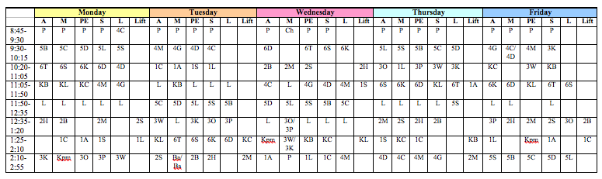
What do you have now?
DRAW A LINE IN THE SAND
What format?

Slide 6
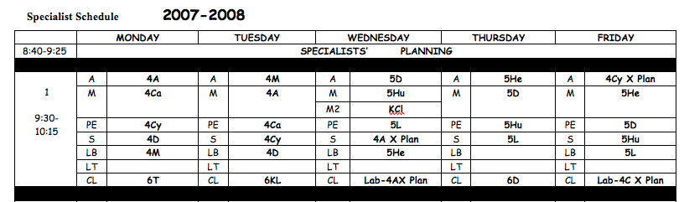
Or this?

Slide 7
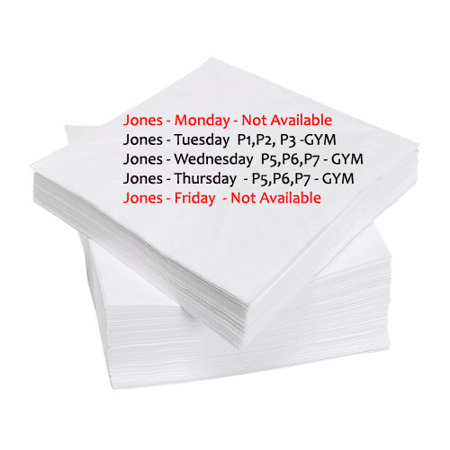

I hope this never happens to you
It did to me!
Is it worth learning a new method?

Slide 8

Thought I would send you an UPDATE
3 years later I thought I would let you know I am still using the tool you provided to me to successfully and quickly setup my school for the new year. Thanks again Bob!
Every time I use this spread sheet of yours to upload my elementary Master Schedule it just makes my freaking day!
David Moon,
Technology Director,
Sultan School District,
Sultan, WA

Slide 9
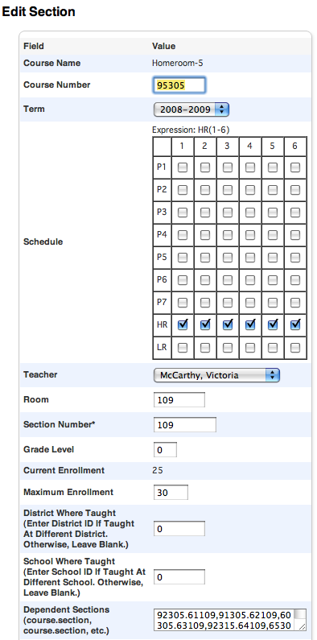
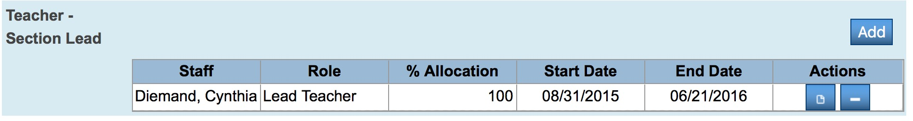
Convert it to this!
Course Name
Course Number
Term Length
Expression- When does it meet?
HR(1-6) would place a √ for each day
Teacher
Room – Where does it meet?
Grade Level – N/A
Section Number- VIP!!! Plenty of ideas here!!
Max Enrollment
Dependent Sections- If enrolled in this class students would also get these courses
WHAT
WHEN
WHO
WHERE
Slight difference – co-teaching later!

Slide 10
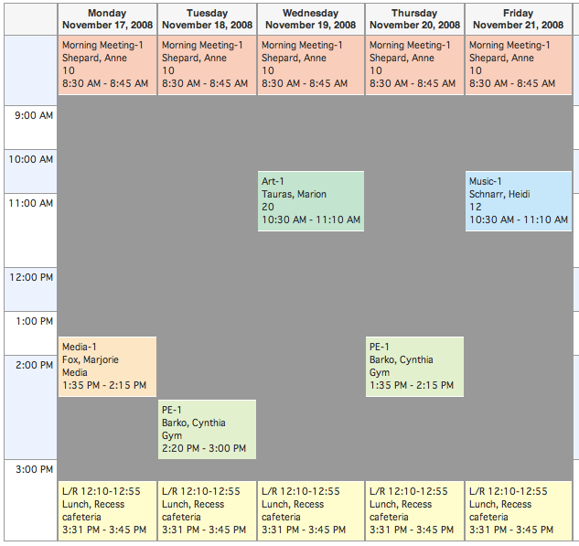
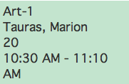

Dependent Sections
PS NEEDS:
WHAT
WHO
WHERE
WHEN
What does the Gray shading mean?
P
E
R
I
O
D
S
3(C)
3(E)
7(A)
8(B), 7(D)

Slide 11
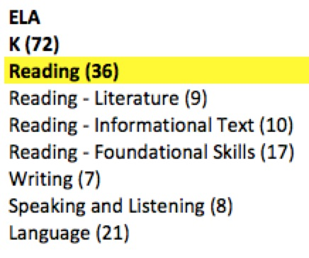

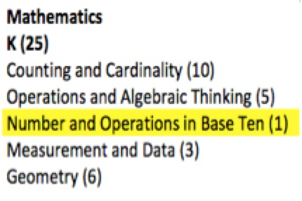

Should Common Core Standards Impact Scheduling?
How many courses are you
planning to use for
English Language Arts?
Reading – Writing
Speaking & Listening - Language

Slide 12
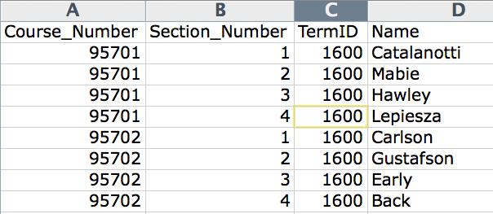
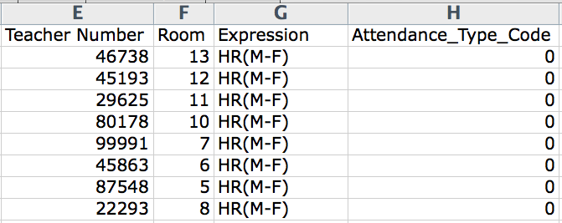
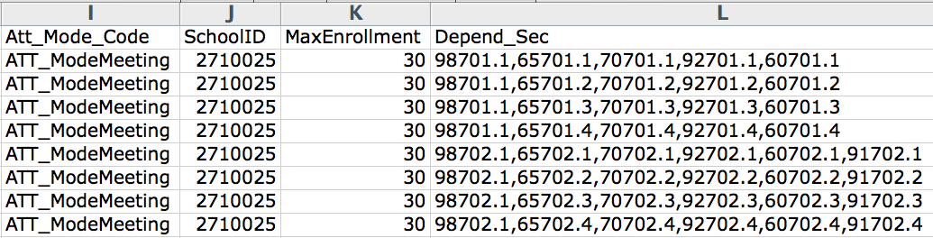
WHERE
WHEN
WHAT
WHO
Scheduling Spreadsheet

Slide 13
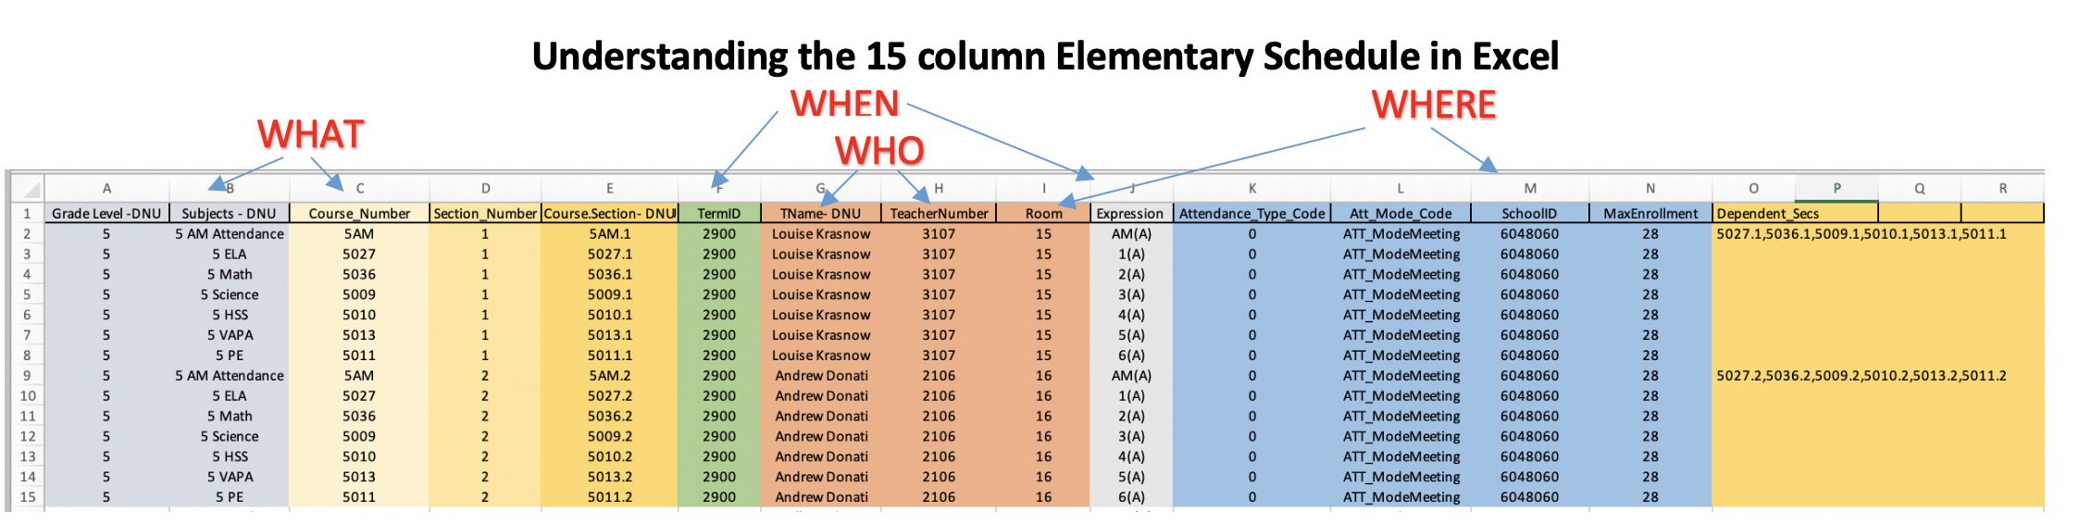
It’s essential you understand the importance of each column and its interdependency on others and your final schedule. In this screenshot above, this represents only 2 teachers. Understanding the columns.
Column A, B, E, G have DNU after the column name = DO NOT USE/IMPORT
Columns K, L, M,N normally do not change from year to year. (BLUE)
Columns E and O are auto generated by a concatenation equation. Enter data correctly in Column C and D and E and O are auto-generated.
Column F (GREEN) will have to be changed ANNUALLY. Next year is 2019-2020 but it has to be 2900 in PS. Why 2900 – it’s the 29th year of PS Scheduling.
Columns G, H, I all relate to the teacher and where he or she teaches – Teacher Name – DNU, TeacherNumber and Room. These may not change much per year. Column J is the expression – when that class actually meets.
Dependent Sections (Column O) – the only course that has dependent sections is Homeroom. That is why all the other courses have that column BLANK. It’s autogenerated.

Slide 14
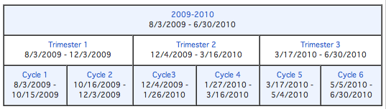
Term ID’s for Less than Full Year Courses!
Full Year Course = 2300
T1 =2301, T2=2302, T3=2303
C1=2304, C2=2305, C3=2306, C4=2307, C5=2308, C6=2309
This year is?
Next year will be?

Slide 15
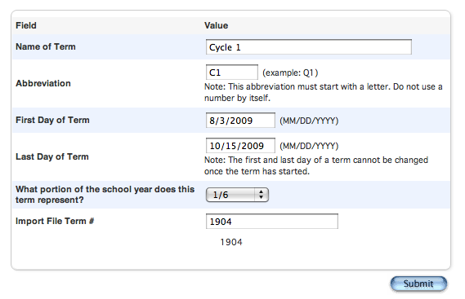
If you are importing – double √√√
Your numbers have to match
Full Year Course = 2300
T1 =2301, T2=2302, T3=2303
C1=2304, C2=2305, C3=2306, C4=2307, C5=2308, C6=2309

Slide 16
Don’t want to start from scratch!
[5]lastfirst
[5]title
[5]teachernumber
[5]status
[5]last_name
[5]first_name
SchoolID
[2]course_name
Course_Number
Dependent_Secs
Expression
^(*class_expression data="abbr" format="expression")
Grade_Level
Section_Number
Team
TermID
Attendance_Type_Code
Att_Mode_Code
Room
Got DDE Experience?
Then Export from the Sections (3) table
Select from this school only
Filter Term ID >= 2500 (for this year)
RED - export but DNU
BLUE - update for next year
ORANGE – rename to Expression to reimport
http://www.derotechnical.com/SCHEDULING/Scheduling.html

Slide 17
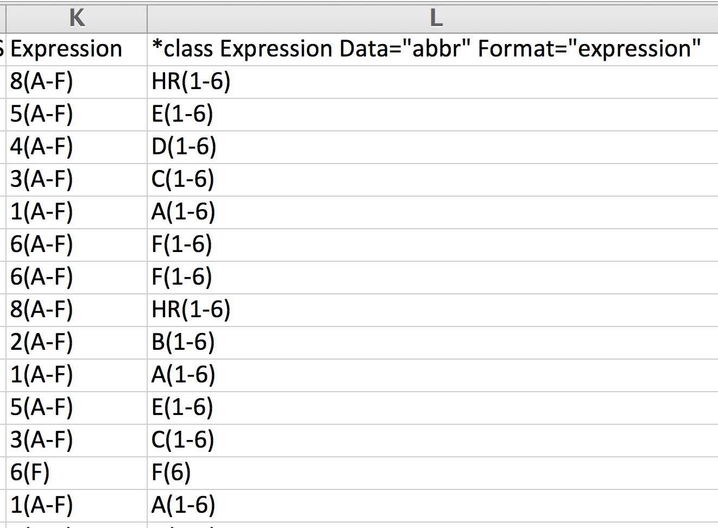
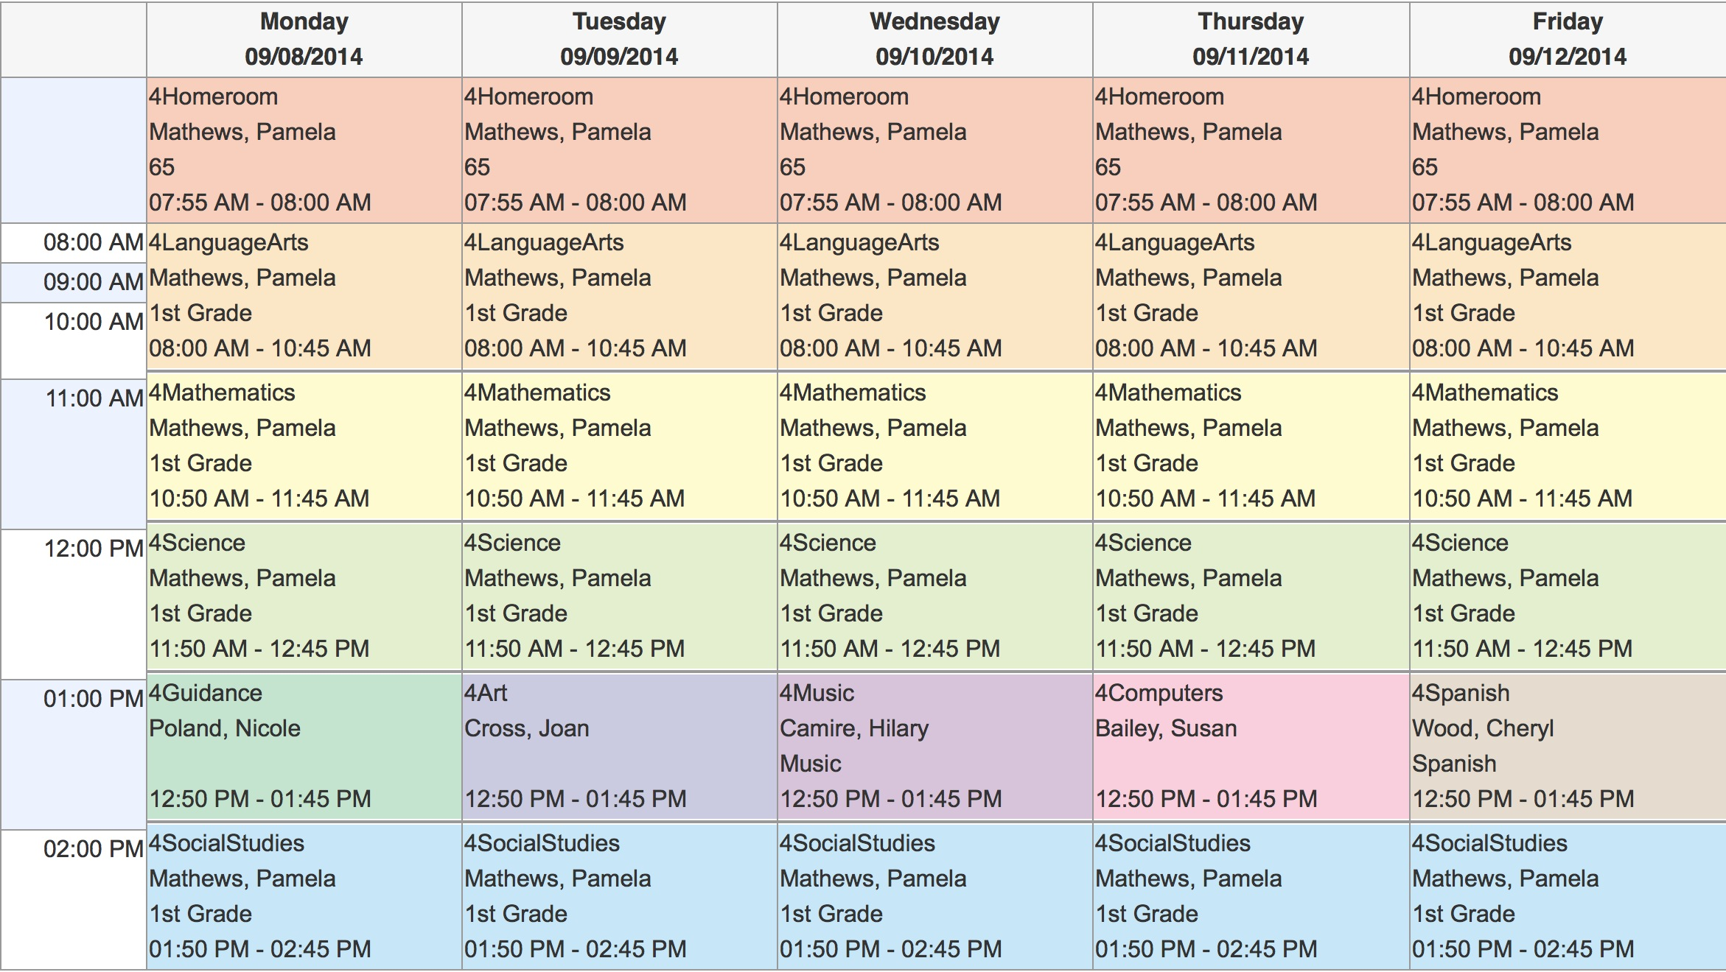
CHANGE AND RENAME Column L to Expression.
Do NOT Reimport Column K

Slide 18
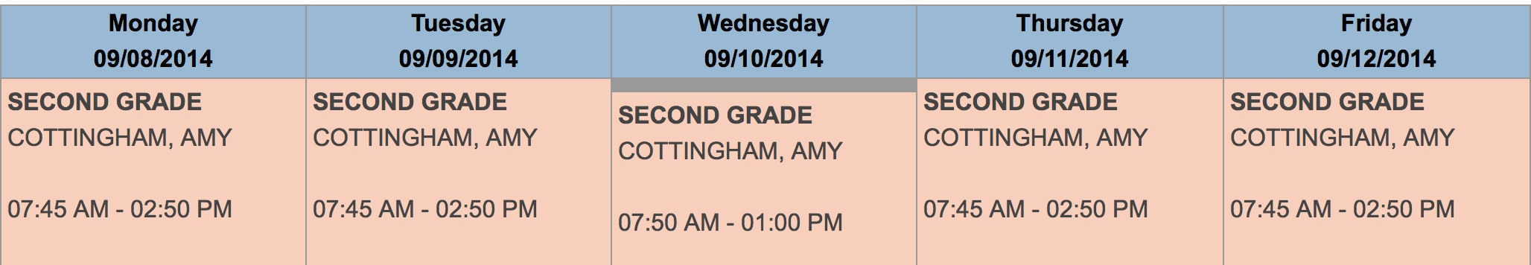
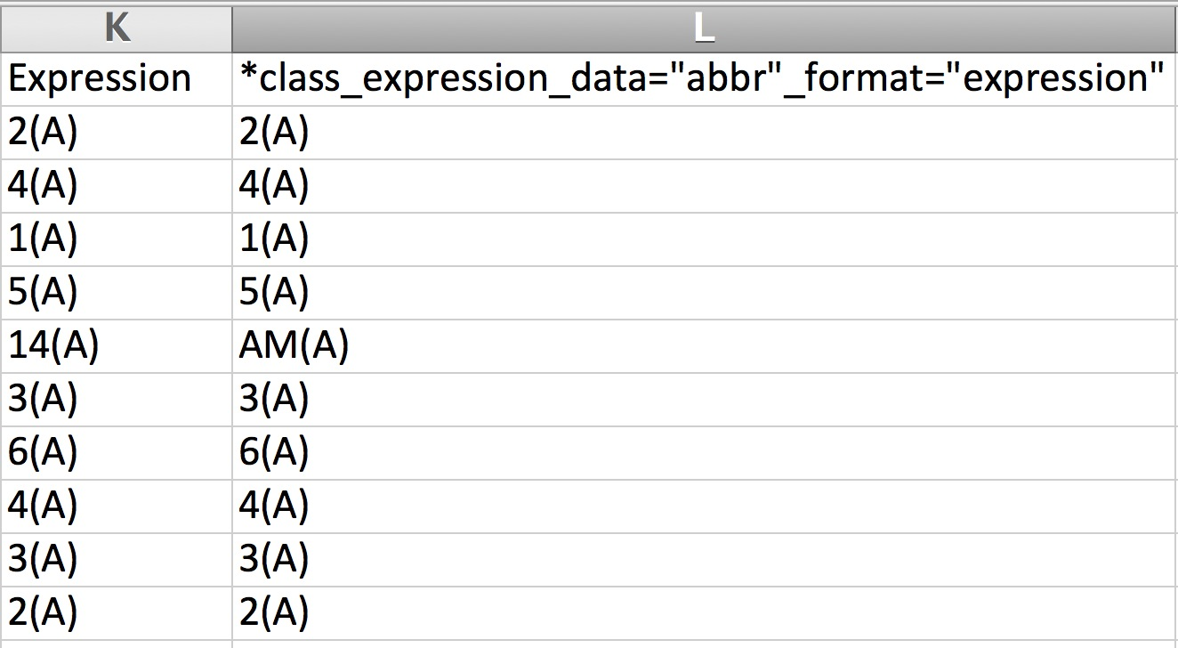
SIMPLE SCHEDULE LESS TWEAKING
RENAME Column L to Expression.
Do NOT Reimport Column K

Slide 19
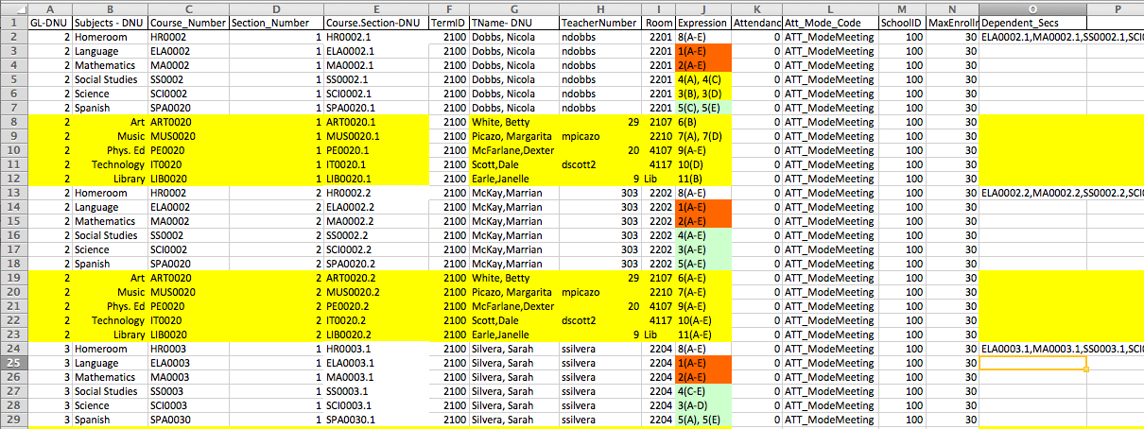
Excel Import File Must Be Converted
WHEN
WHAT
DNU- DO NOT IMPORT
Visual Clues
WHO
WHERE
Dependent Sections REQUIRES course.section,course.section,course.section
You can manually enter them OR….

Slide 20
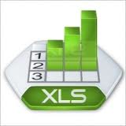

Excellent with Excel?
Course.Section=CONCATENATE(C3,".",D3)
Dependency=course.section,course.section etc
=CONCATENATE(E4,",",E5,",",E6,",",E7,",",E8,",",E9,",",E10,",",E11,",",E12)
http://www.derotechnical.com/SCHEDULING/Scheduling.html
Culture Club’s - Karma Chameleon
,”,”, ,”,”, ,”,”, ,”,”,

Slide 21
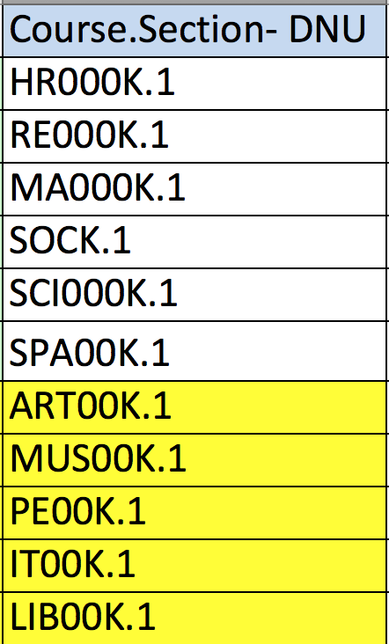
Depend Sections – depend_secs
Dependency=course.section,course.section, etc

Slide 22
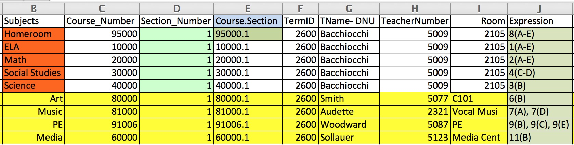
WHAT
WHEN
WHO
WHERE
WHEN
NORMAL ELEMENTARY SCHEDULE....
HR Teacher appears on the spreadsheet 5 times - HR, ELA, MA, SS, SCI
Below list all the special subjects that his or her students take with other teachers
Once one HR teacher and his/her core subjects and specials are listed, copy/paste/change for teacher #2 for that same grade level. Repeat until all HR teachers for that grade level are complete

Slide 23
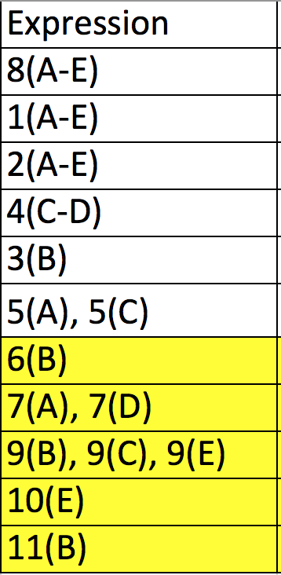
Expressions Period(Days) PRINT THIS PAGE
Days
Monday = A
Tuesday = B
Wednesday = C
Thursday = D
Friday = E
Periods
1
2
3
4
5
6
7
8
9
10
11
Rules for Expressions
Contiguous Days use a DASH
(A-E) (A-C) (A-B)
Single Meeting Date
Period(Day)
Multiple meetings per week
Non-contiguous
Expression, SPACE Expression
5(A), 5(C)
9(B), 9(C), 9(E) or
9(B-C), 9(E)
Bell Schedule sets the time of these periods. If you need more periods that is done under Years and Terms

Slide 24

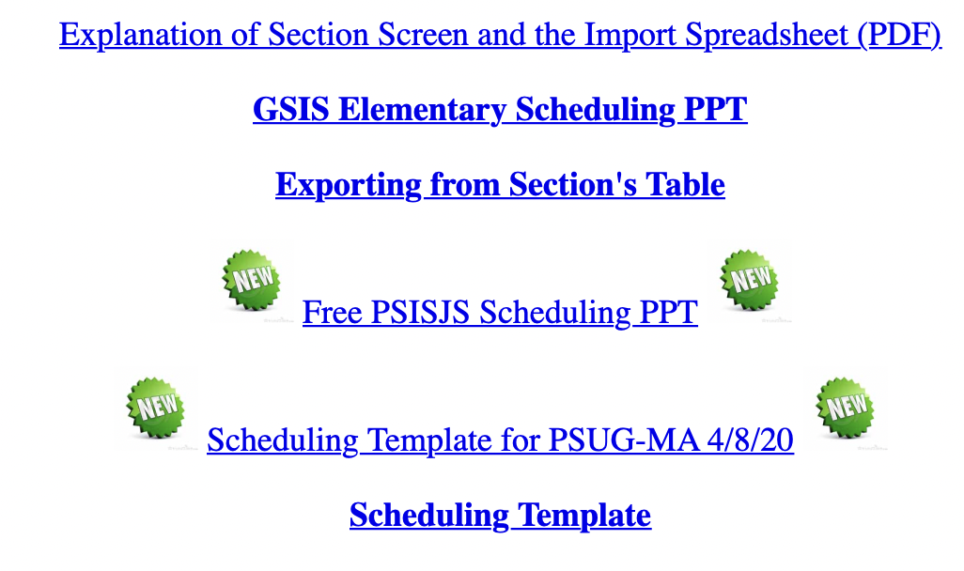

Slide 25
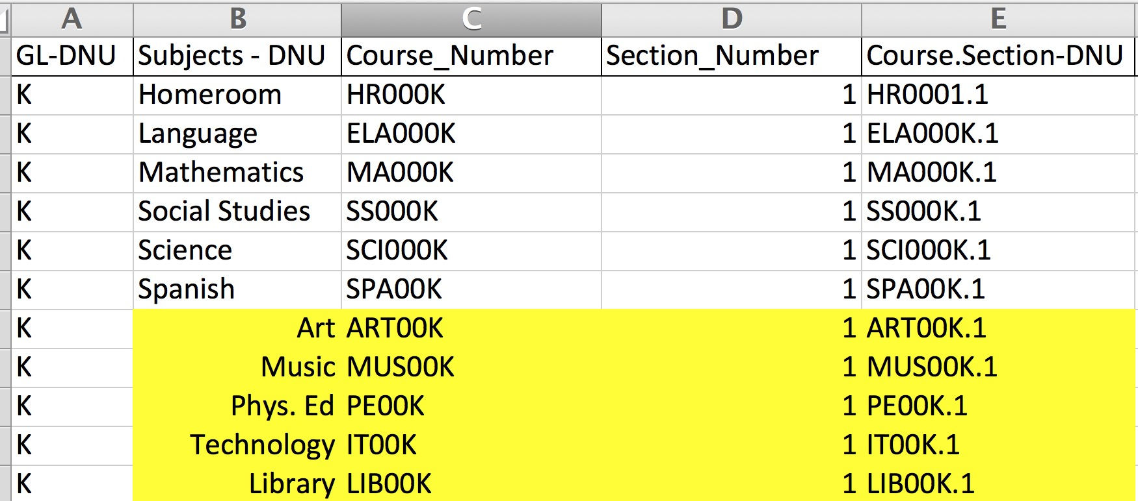
CLOSER LOOK AT THE COLUMNS

Slide 26
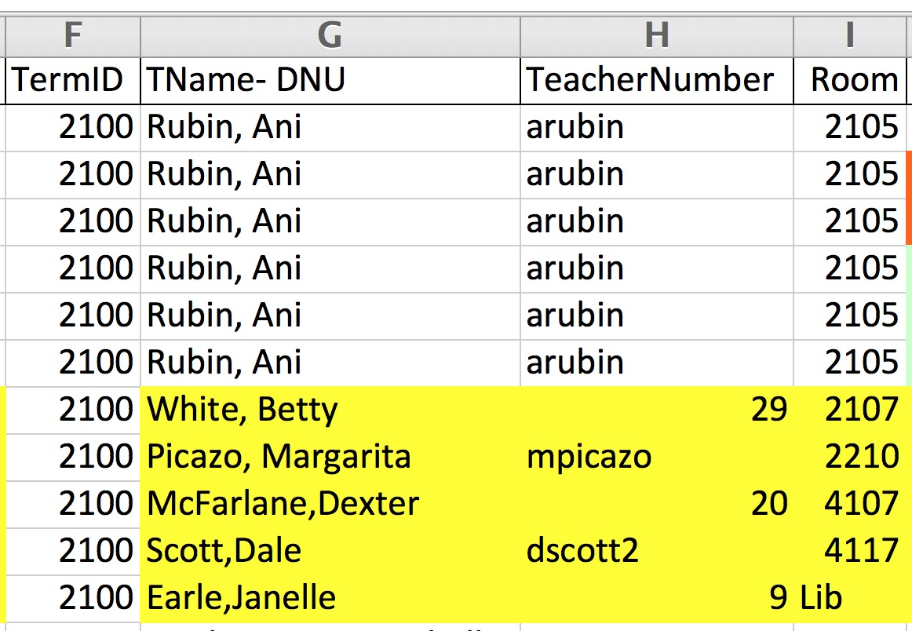
CLOSER LOOK AT THE COLUMNS

Slide 27
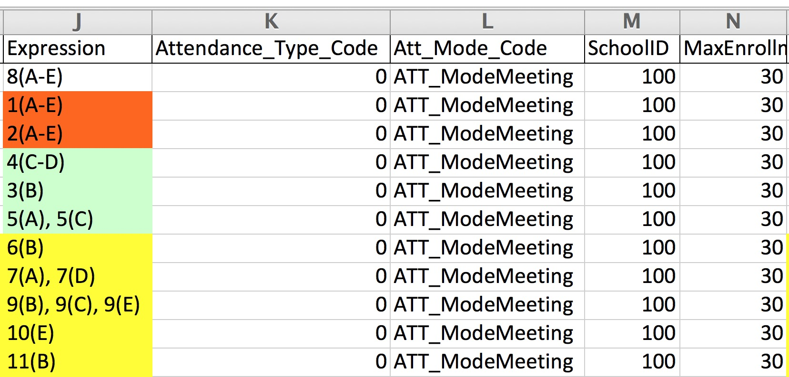
CLOSER LOOK AT THE COLUMNS

Slide 28
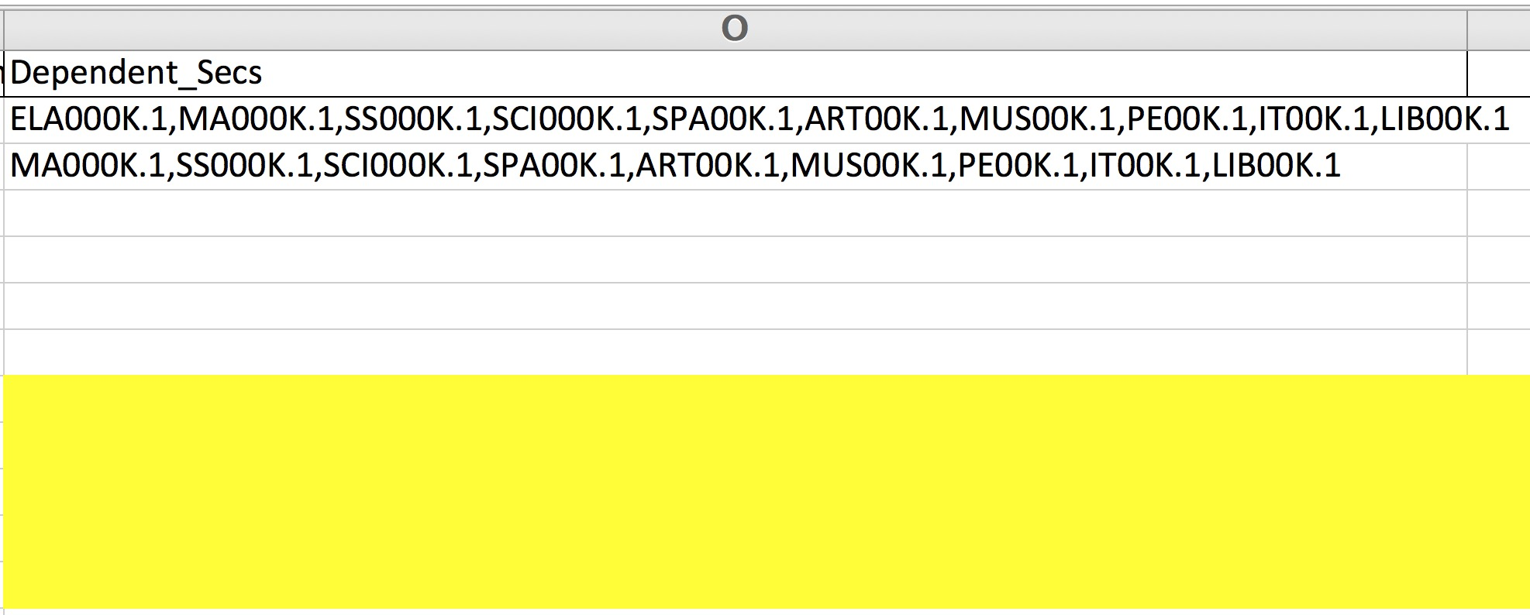
CLOSER LOOK AT THE COLUMNS

Slide 29

Dependent Section Options
HR >> ELA, MA, SCI, SS and SPECIALS if the students travel to ART, MUSIC, PE, HEALTH etc as a HR Group
If students go to SPECIALS as a new group other than HR but stay together as a group in these elective subjects then…
PE>> ART, MUSIC, HEALTH, LIBRARY
( upper elementary & MS Schools)

Slide 30
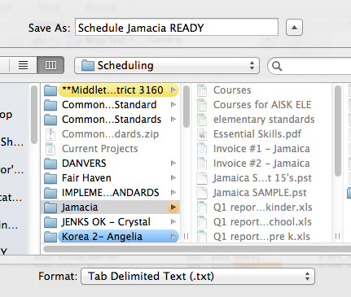
Best Practices – READY.txt

Slide 31
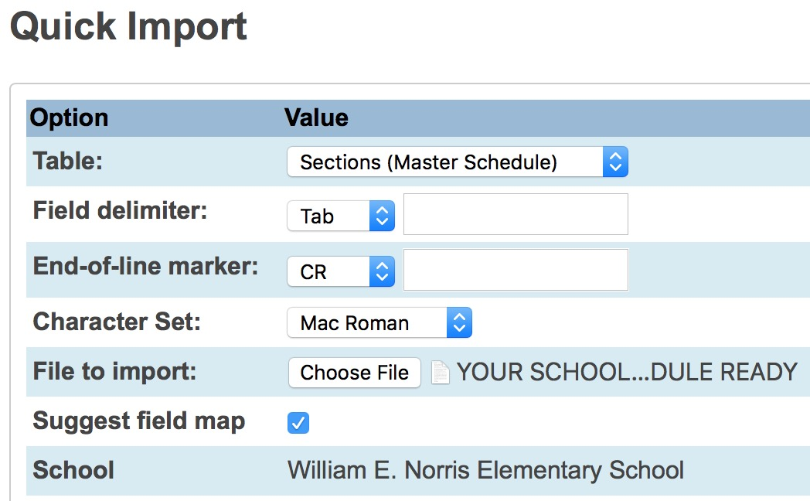
Importing Schedule into PowerSchool
Convert XLS to TEXT File (READY)
Special Functions
Importing and Exporting
Quick Import
Table- Sections (Master Schedule)
Find TXT file READY ( converted XLS file )
Match column names to those in PS

Slide 32
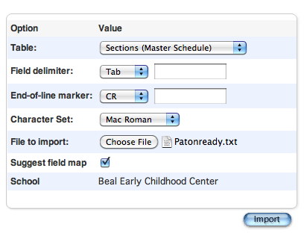
Import into the Sections (Master Schedule)
Never REMOVE √

Slide 33
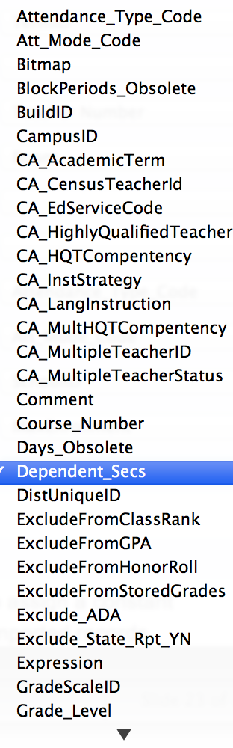
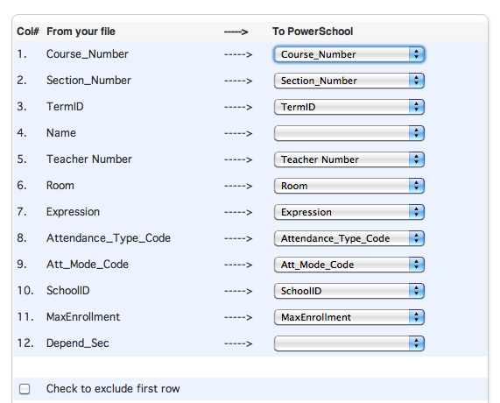
Suggested Field Map
√
Removes Column Headers that were used in Excel
Name is not used in PS, but I use it as a visual clue.
Do you know your teacher numbers?
ANY File Headers in EXCEL on LEFT with DNU will not match
PS Fields on Right.

Slide 34
After Import – RED is BAD!
After importing PowerSchool displays a page with your results.
RED is an error and it “clearly” tells you ( HA!) what these mean. Go slow it’s doable
Typical Errors:
  Bad teacher numbers
  Expression is wrong
  Term ID is wrong/not set

Slide 35
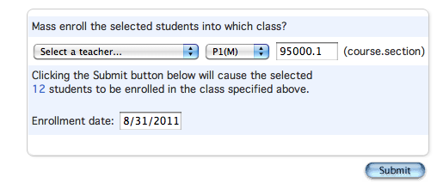
Mass Enroll Function
AFTER EOY AFTER EOY AFTER EOY
Course.Section this identifies your teachers/rooms and periods
Enrollment Date – NORMALLY first day of school .
This date is always the date of your action, you must change it!

Slide 36
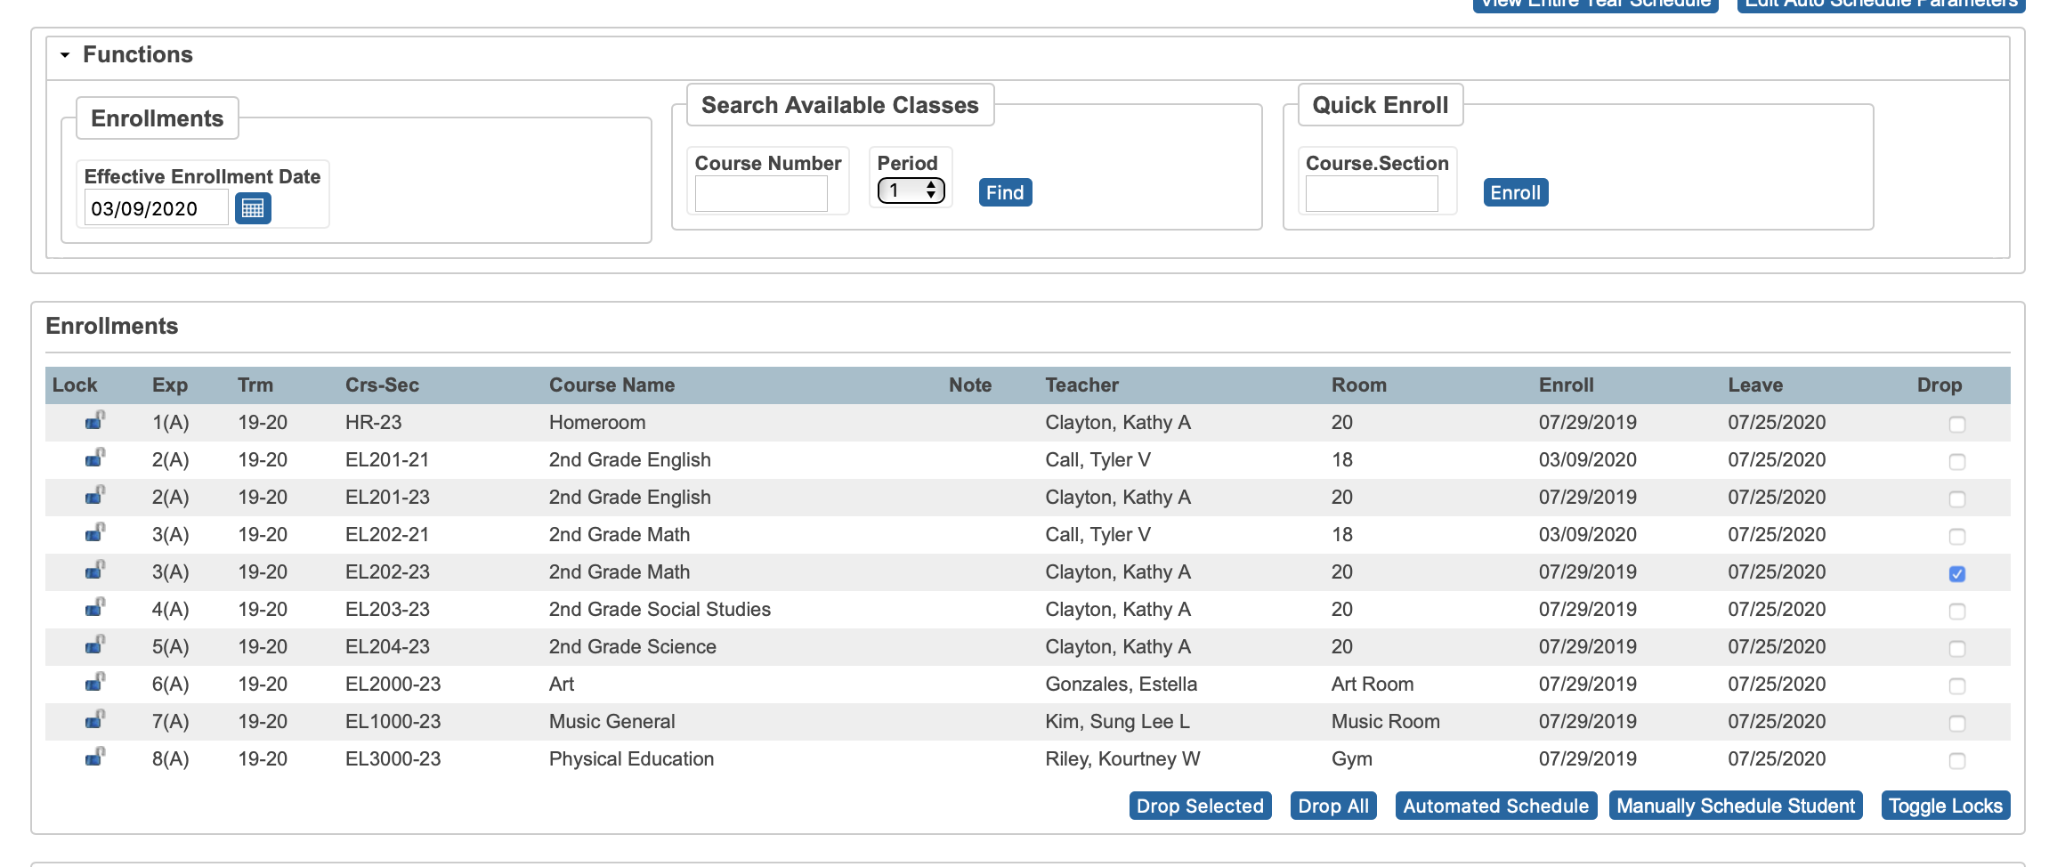
Changing a student’s schedule
I’ll demo it and if you send me an email, I have a handout on this as well

Slide 37
ANY AND ALL DERO RESOURCES ARE AVAILABLE
TO DOWNLOAD, TWEAK and USE FOR YOUR DISTRICT!
Q & A
Bob Cornacchioli
get2bobc@gmail.com
www.derotechnical.com
Let’s download my sample
scheduling spreadsheet

Slide 38



Visual PST
evScheduler
If you would like a demo
license – please email me
get2bobc@gmail.com
FREE DEMO normally
$450 per year per district

Slide 39
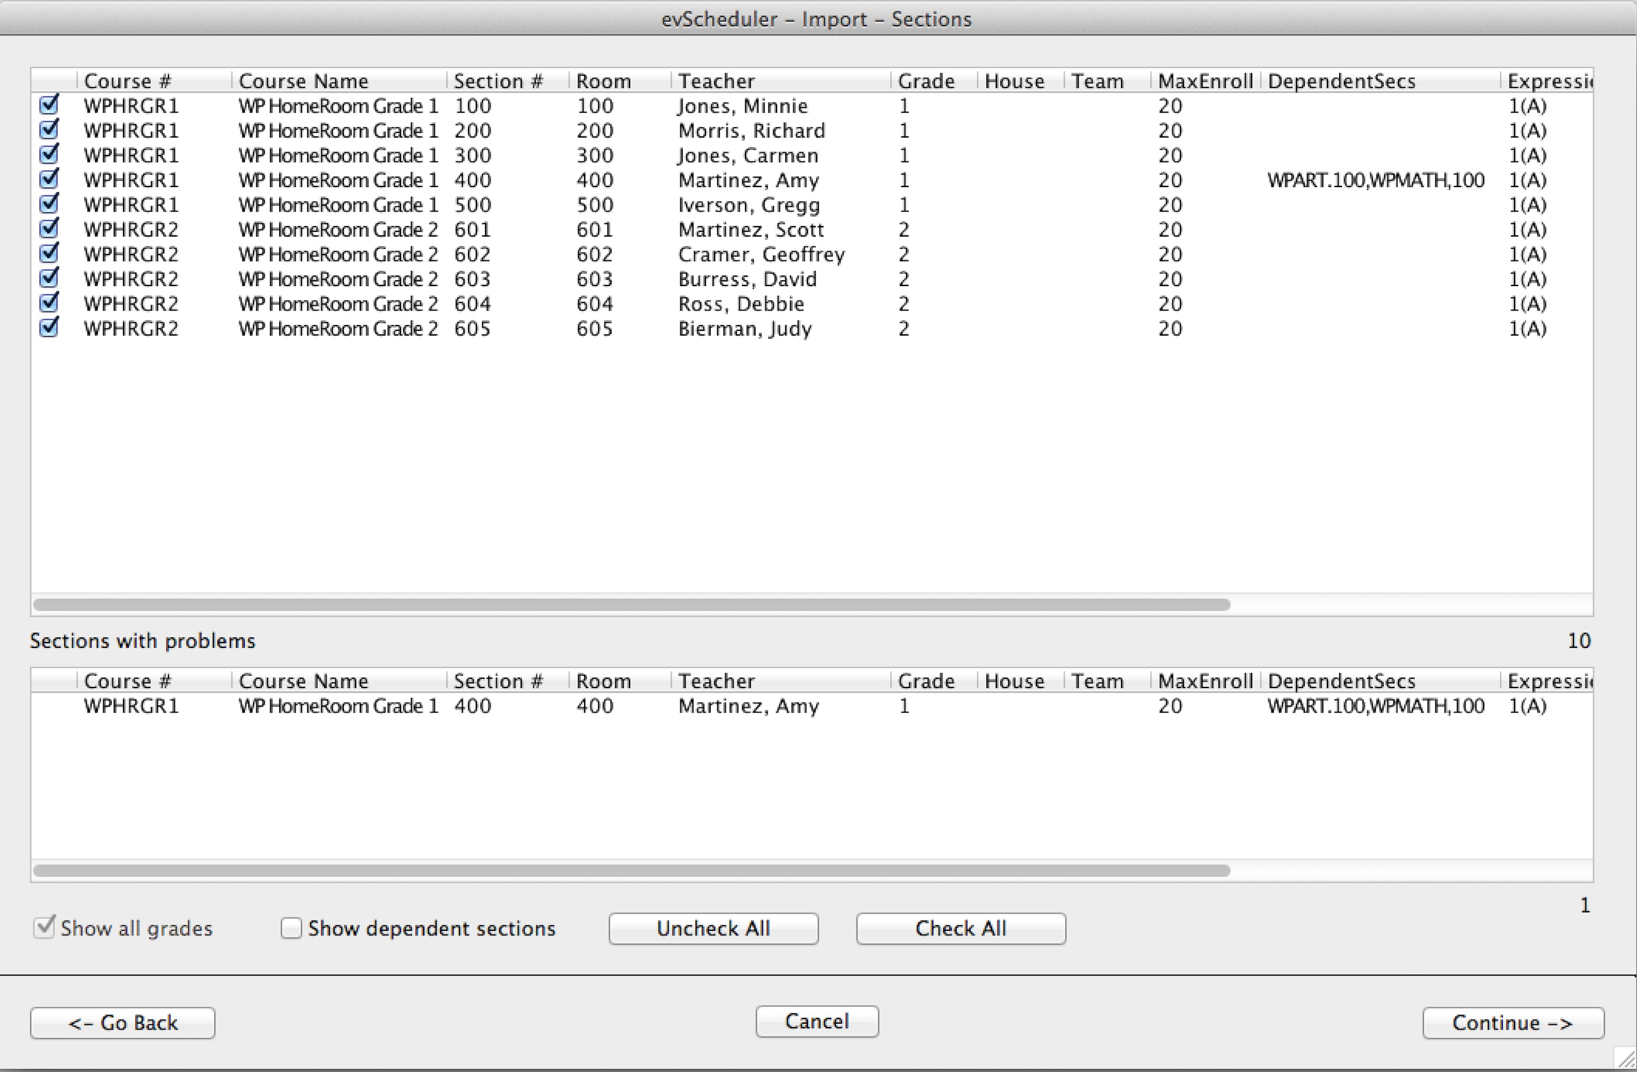
evScheduler
ODBC/ PowerSchool (Pulls data from Live or Schedule side)
SET-UP QUESTIONS – what grades, what classes, teachers, dependent sections etc.

Slide 40
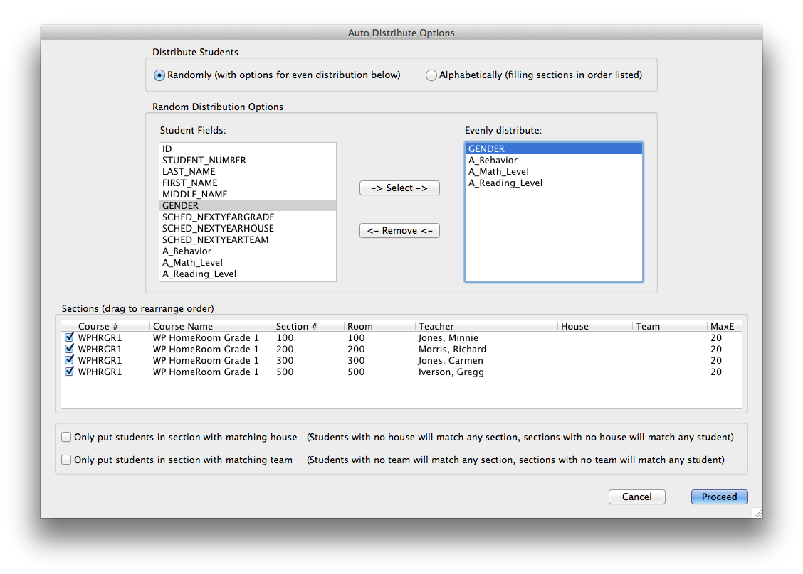
evScheduler

Slide 41
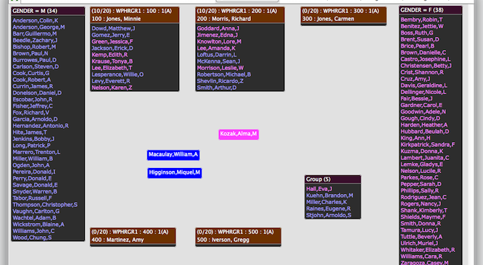
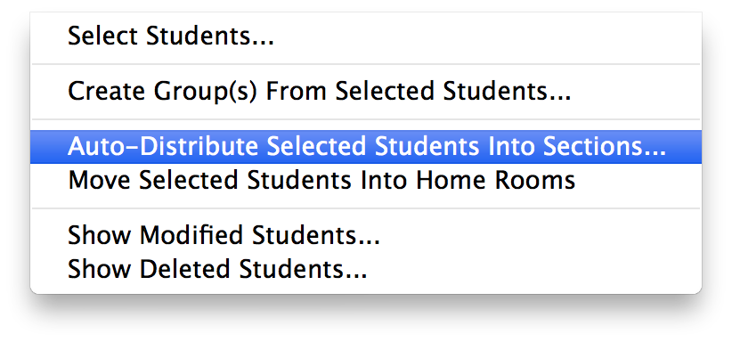
evScheduler
ODBC/ PowerSchool
(Pulls data from Live or Schedule side)

Slide 42
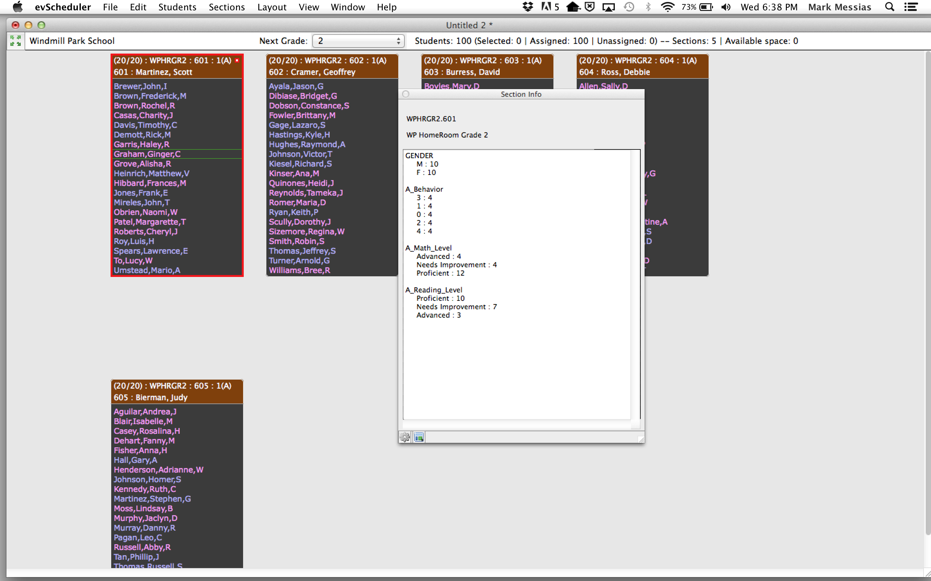
evScheduler

Slide 43
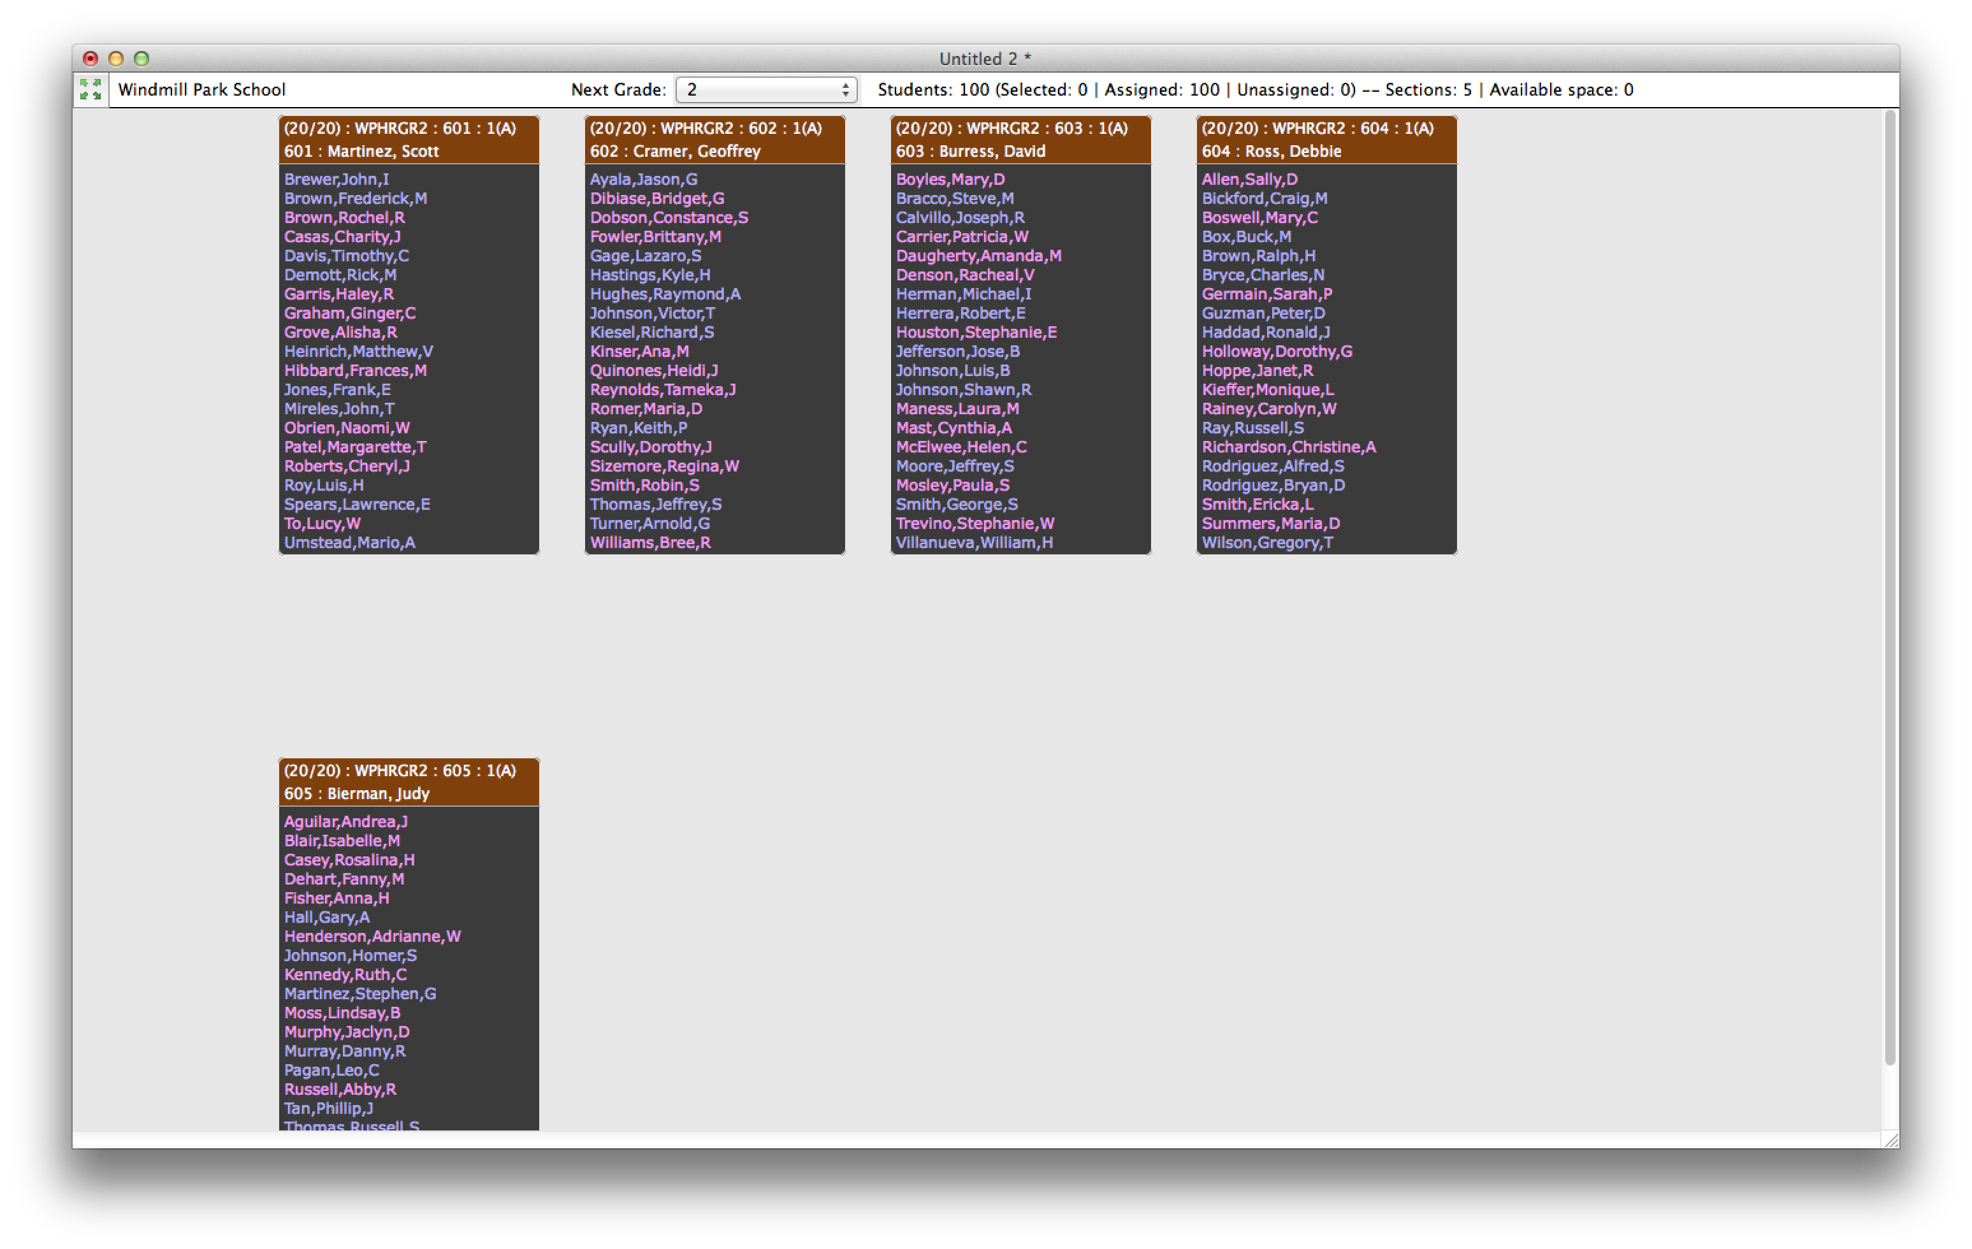
evScheduler
Drag and drop scheduling – Boys and Girls
When you are set- you EXPORT
two text files for:
your schedule
your enrollment

