Slide 1


Creating an Elementary Report Card with Visual PST by ParkBench
Bob Cornacchioli
get2bobc@gmail.com
http://www.derotechnical.com

Slide 2
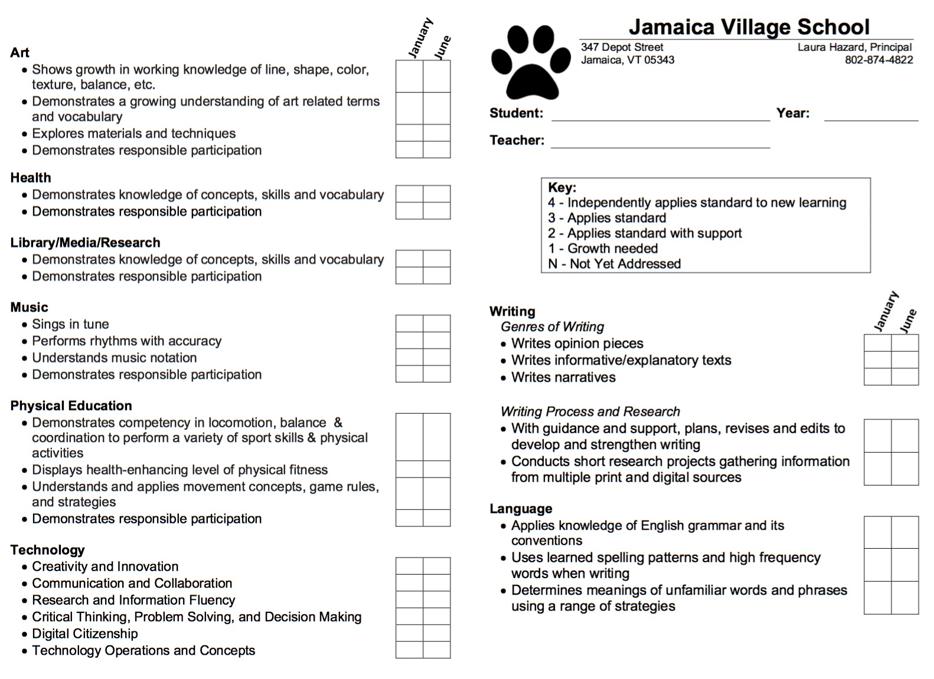
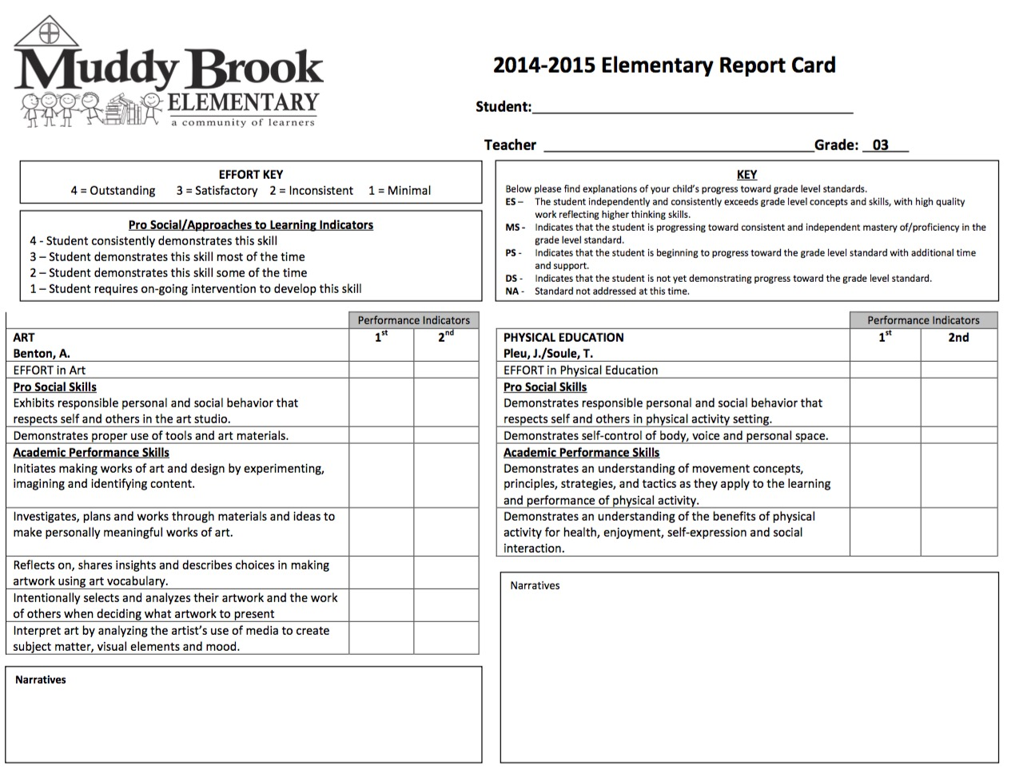
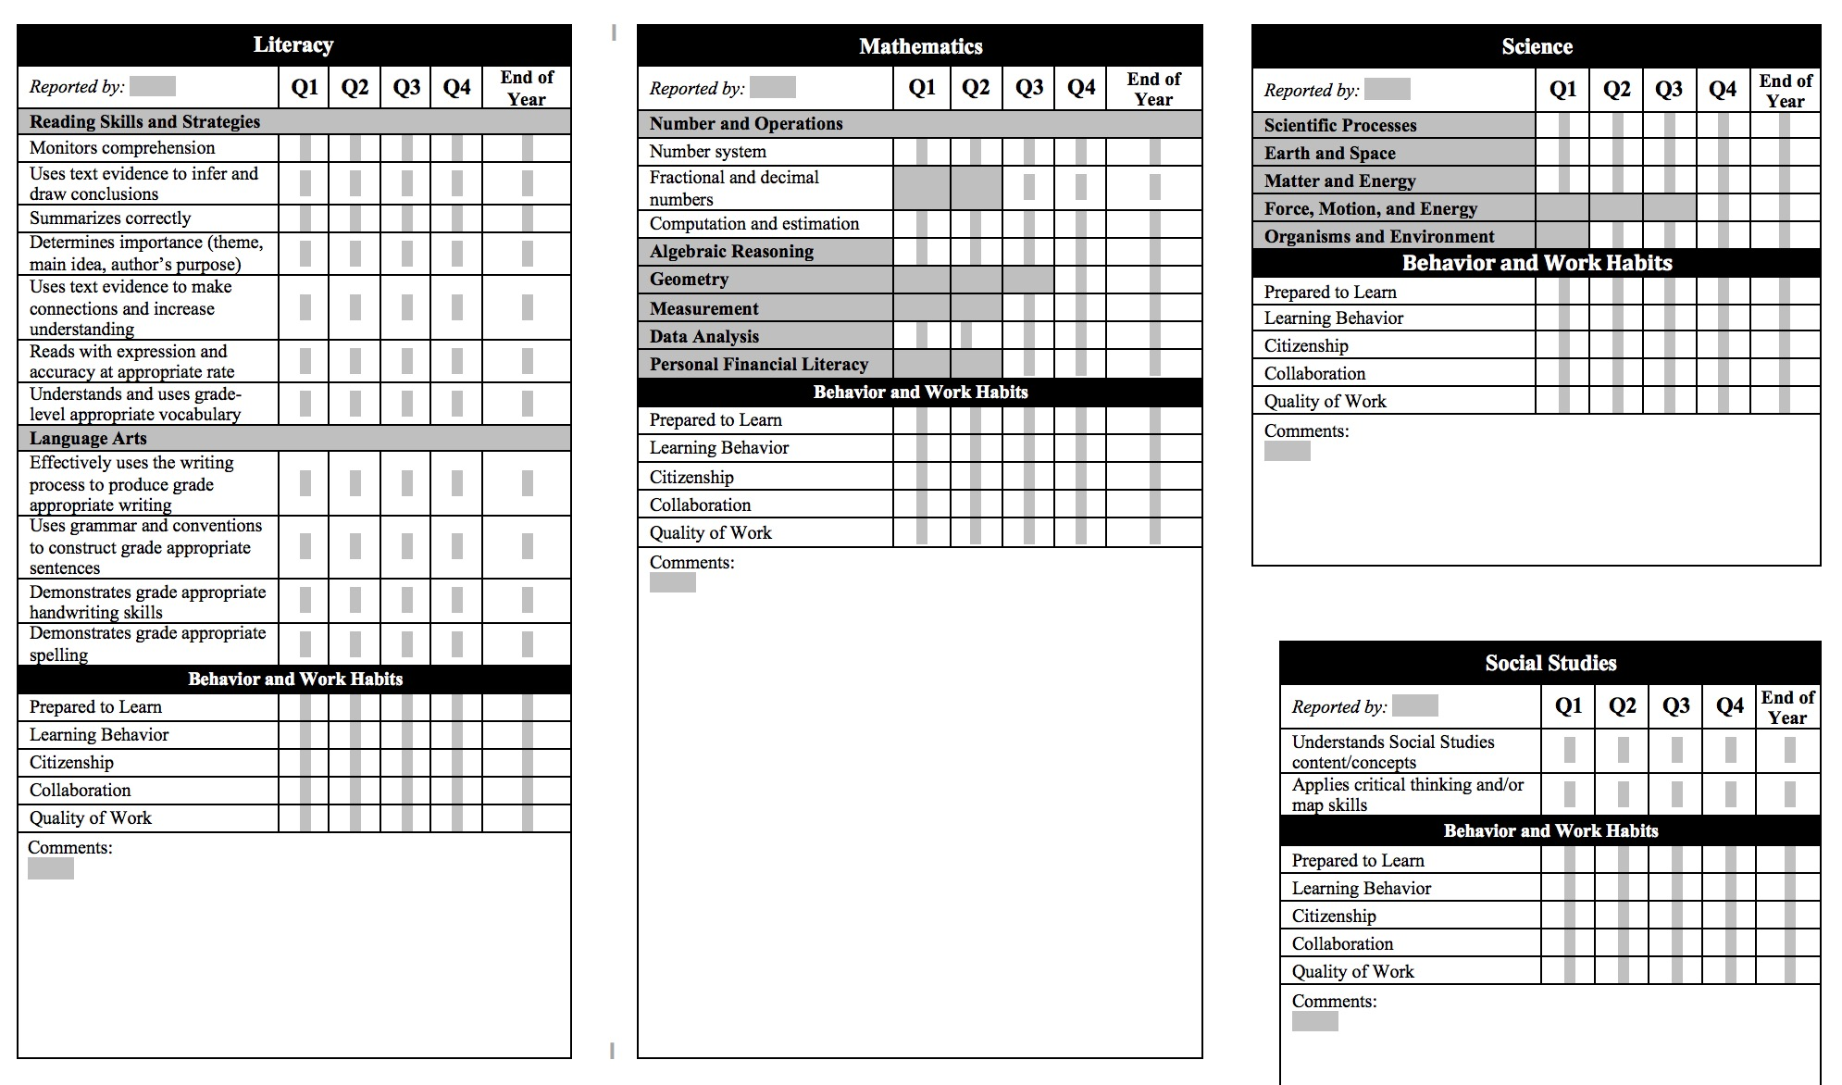
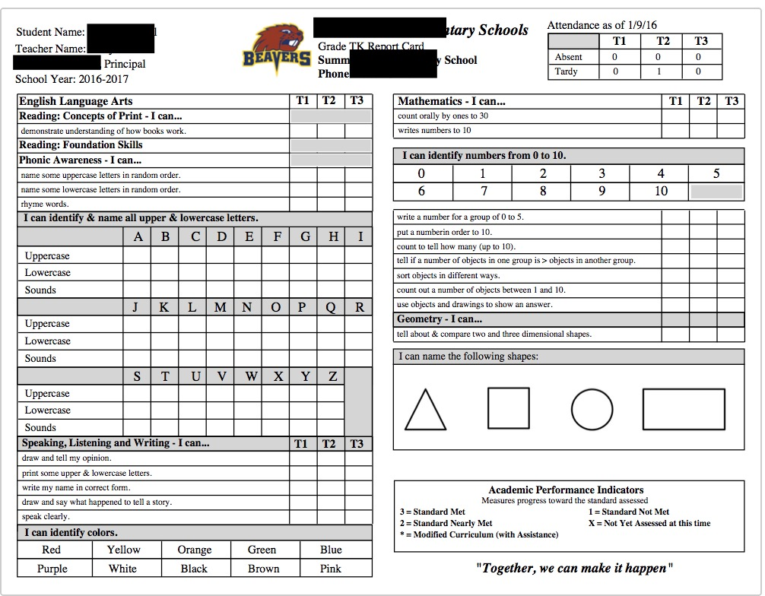
MUST HAVE’s – WORK AROUNDS
DO YOU HAVE AN EXAMPLE?

Slide 3

Today’s Agenda
Intro to ParkBench Visual PST Object Report Writer
Creation Tools
Modification Tools
PS CODES Handout and INSERTING Code
Downloading/Uploading to/from Server
Disabled Scores – AKA positioning of Gray Boxes
Managing PowerSchool Data (standards)
Q & A – get2bobc@gmail.com
All PPT can be found @
www.derotechnical.com

Slide 4



CEO - DERO Technical Services (2007)
Marketing/- ParkBench Software Trainer (2007)
Evangelist/Process Lead- Level Data (2010)
PSISJS Partner – Standards/Trainer (2013)
Alpha/Beta Team for PS and PTP
Bob Cornacchioli
Director of Technology and Media Services
Shrewsbury Public Schools (16 yrs.)
PowerSchool Administrator (6 yrs.)

Slide 5


Trained in Object Reports?
Created Standard Based Report Cards?
Hybrid Report with Traditional & Standard grades?

Slide 6
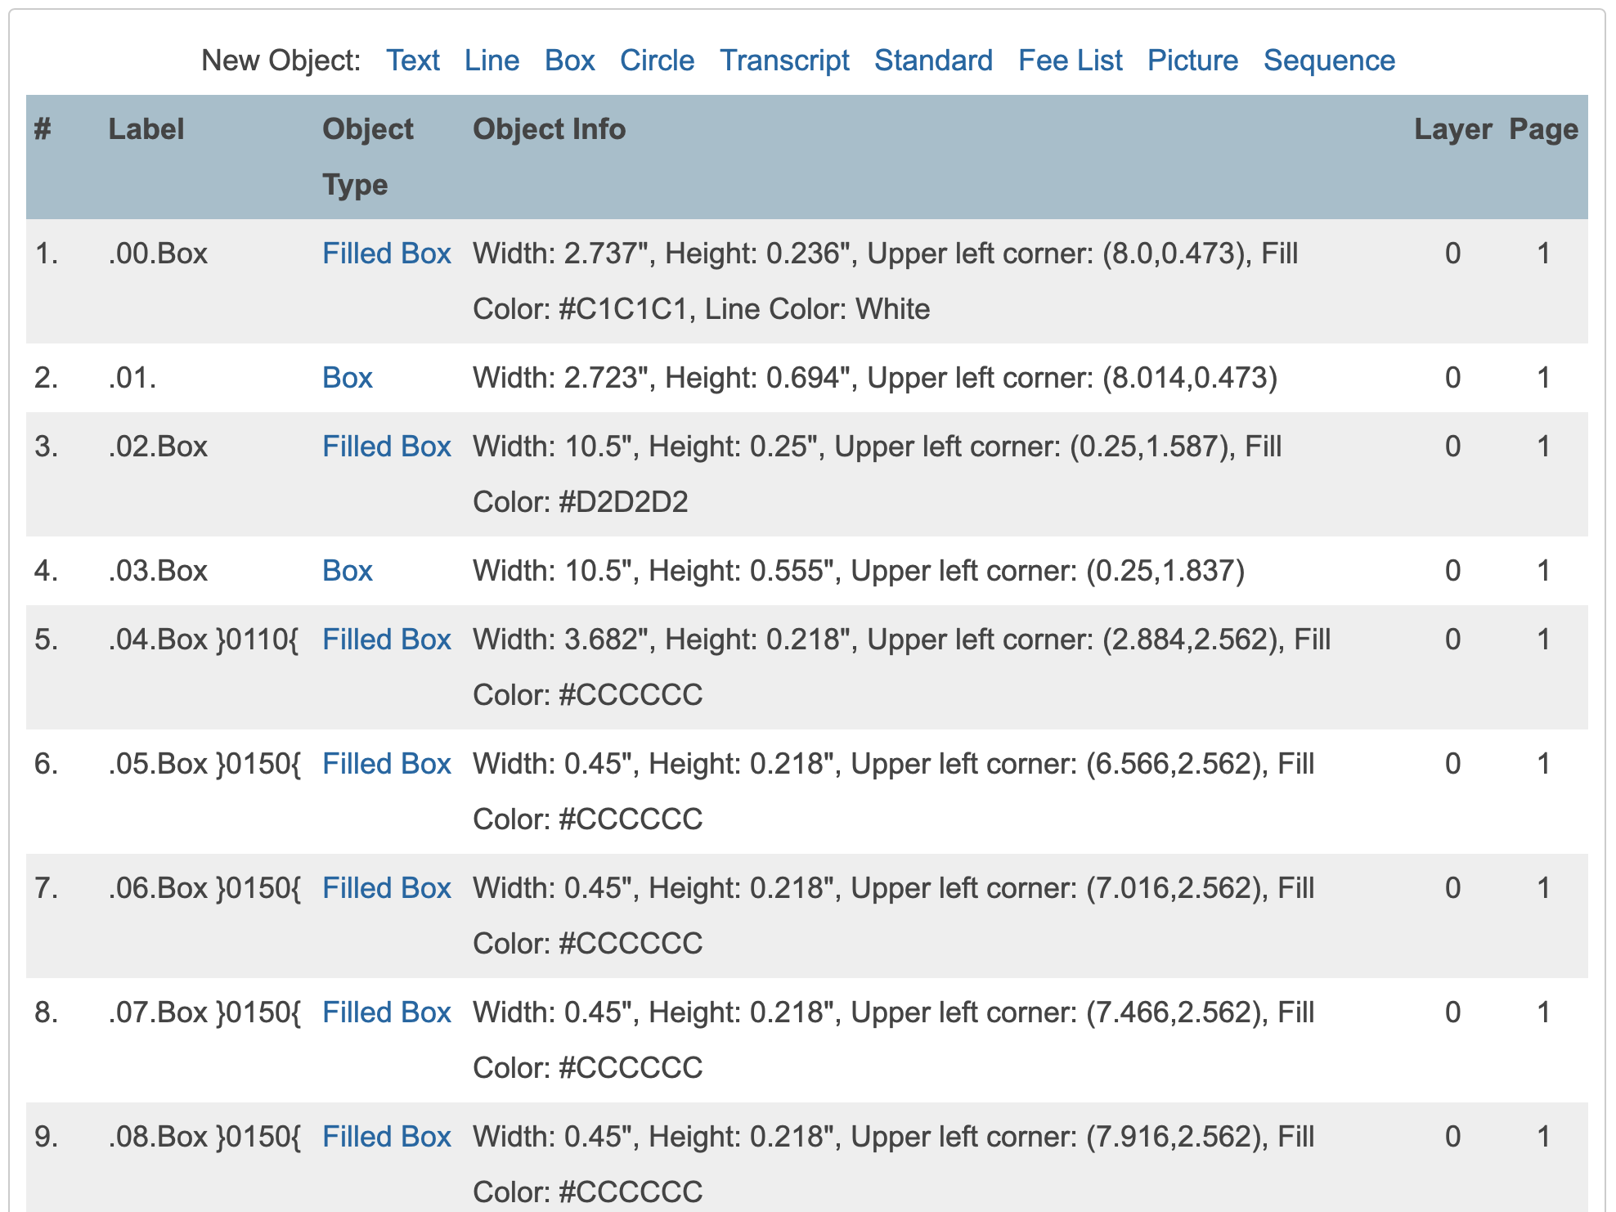
THIS OR…

Slide 7
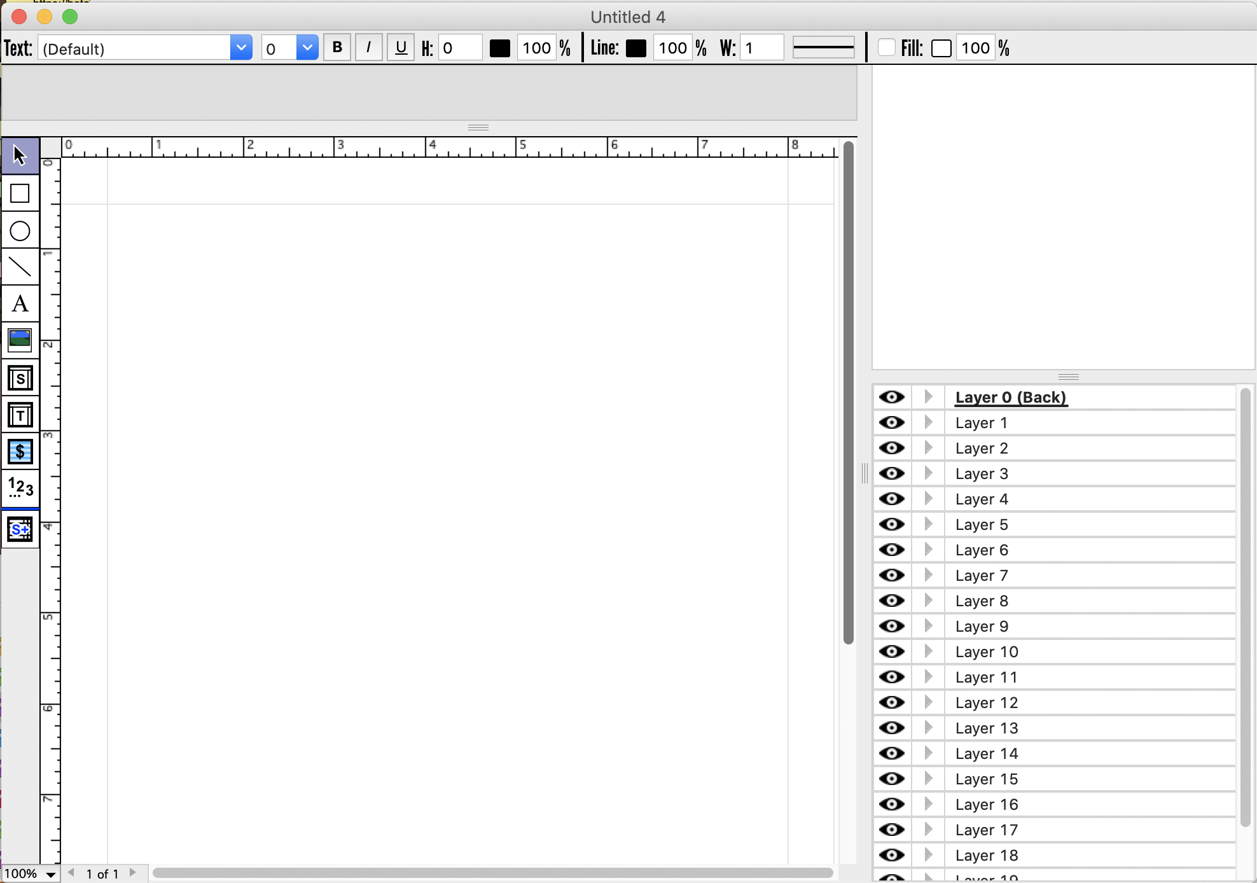
MODIFICATION TOOLS
CREATION TOOLS

Slide 8
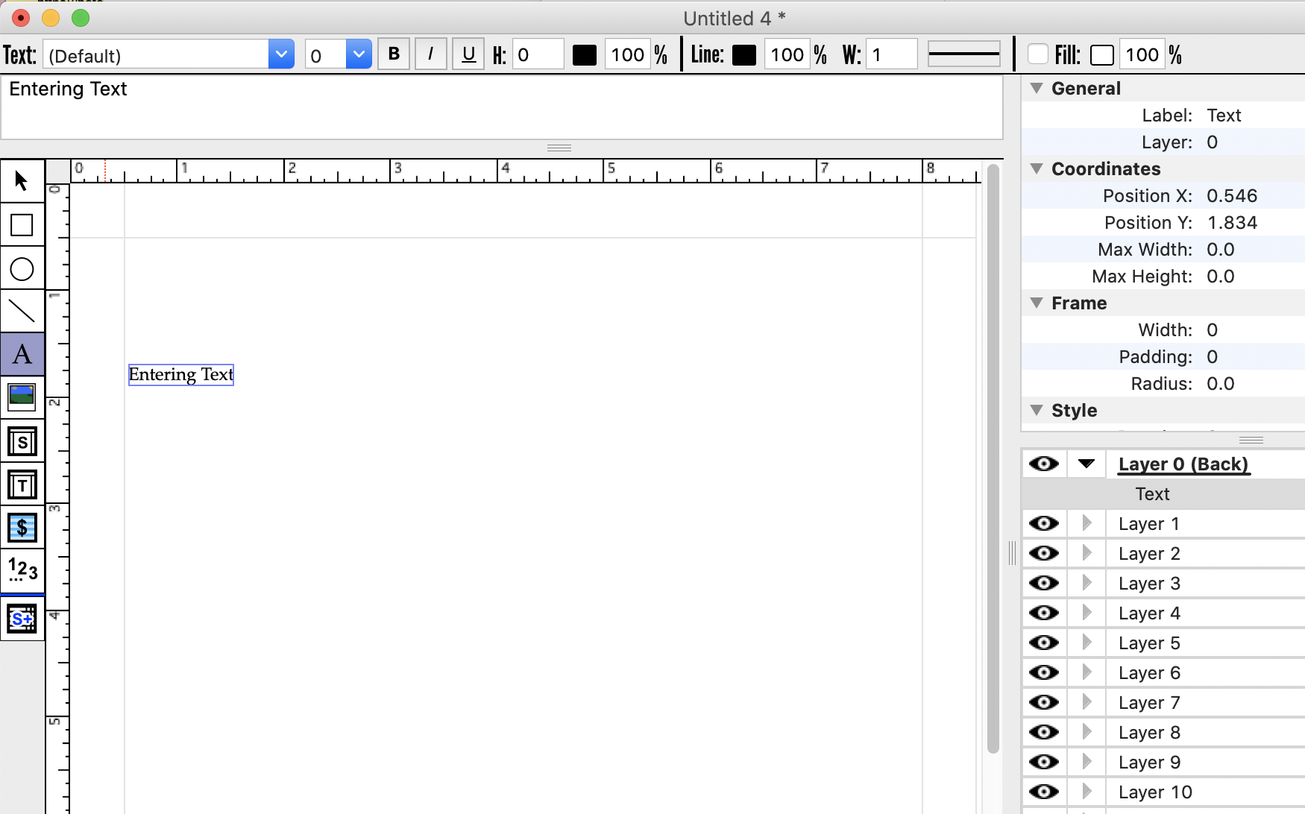
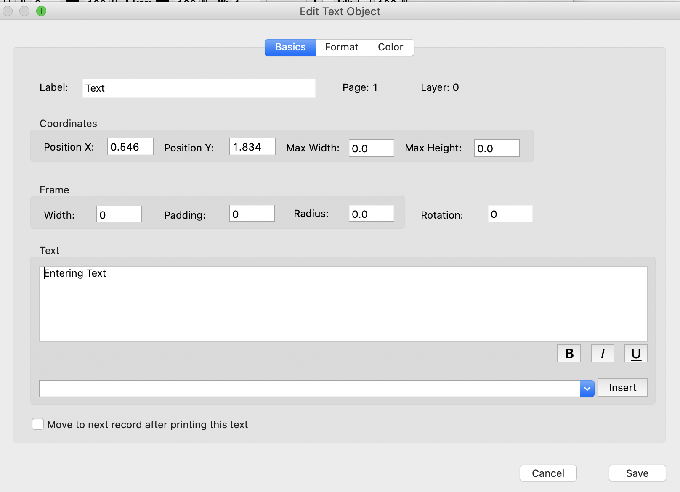
TEXT EDITOR

Slide 9
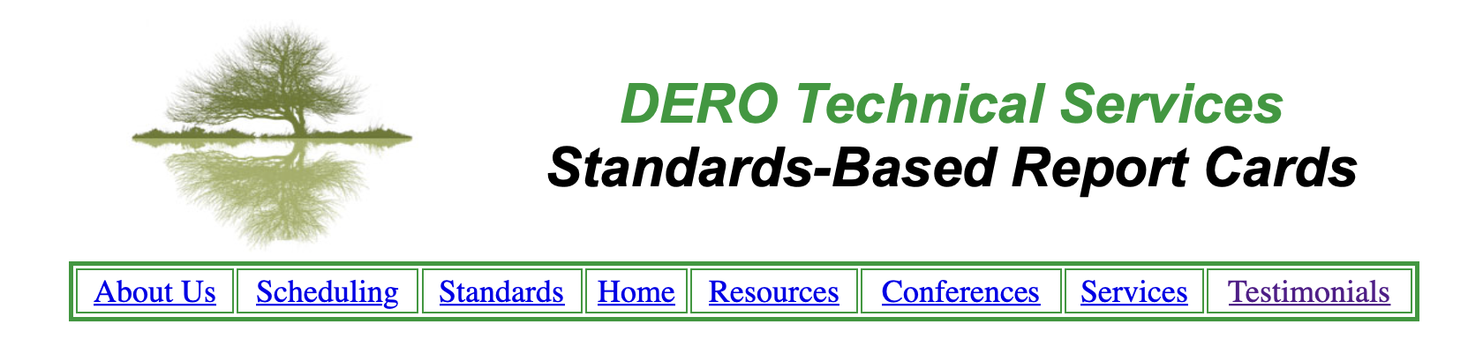
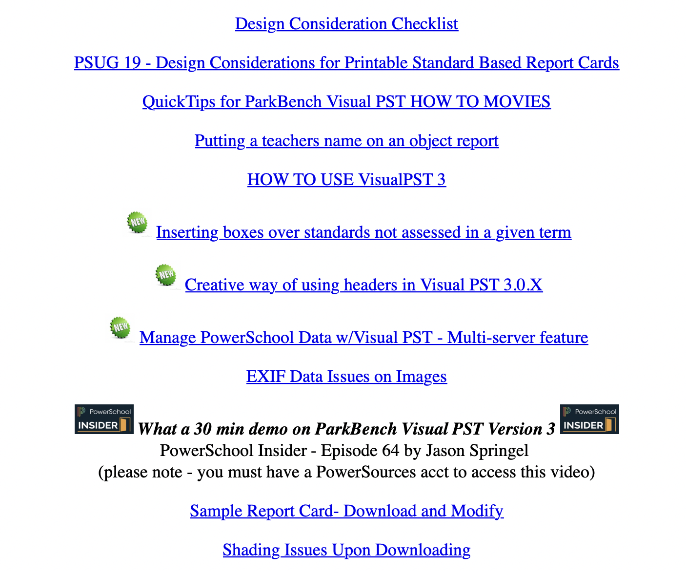

Slide 10
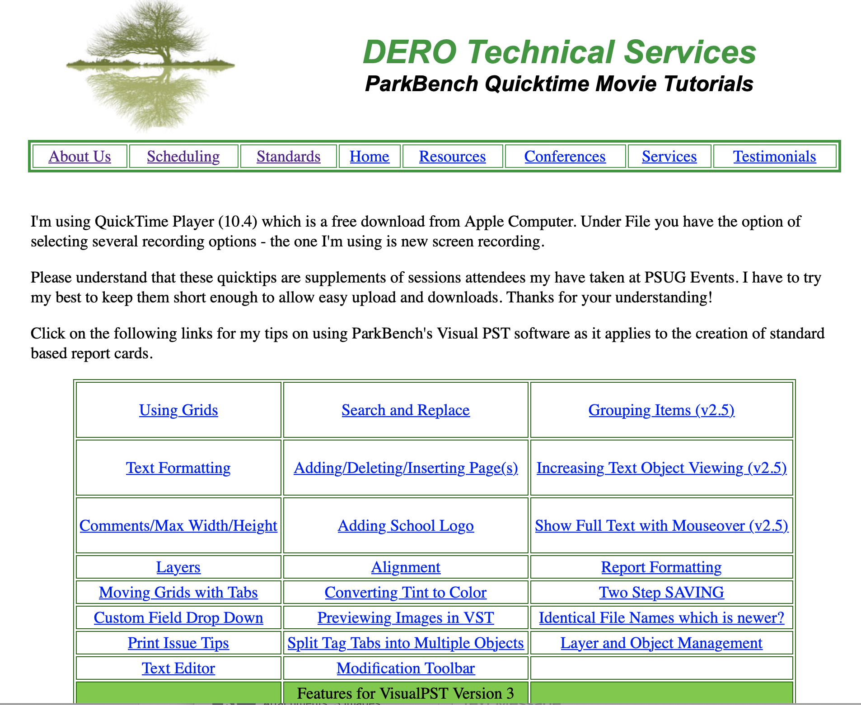

Slide 11
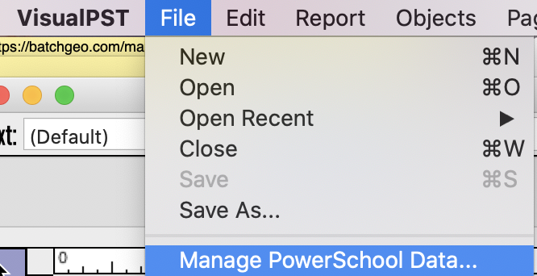
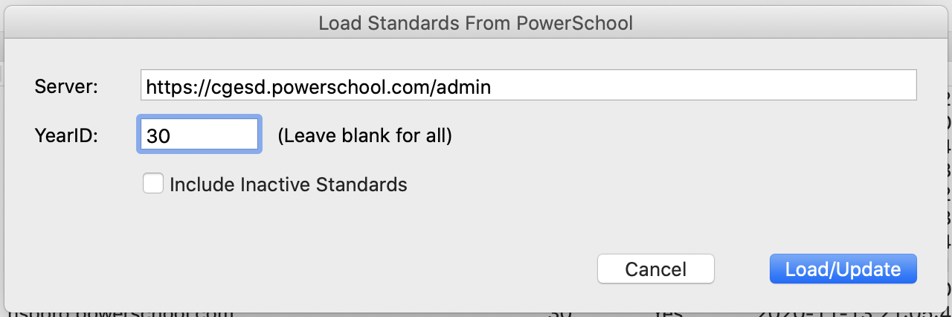
PLEASE NOTE – IF YOU DO NOT HAVE ACCESS TO STANDARDS
THIS STEP WILL NOT WORK – VST PROTECTS
THE PERMISSIONS YOU HAVE SET UP

Slide 12
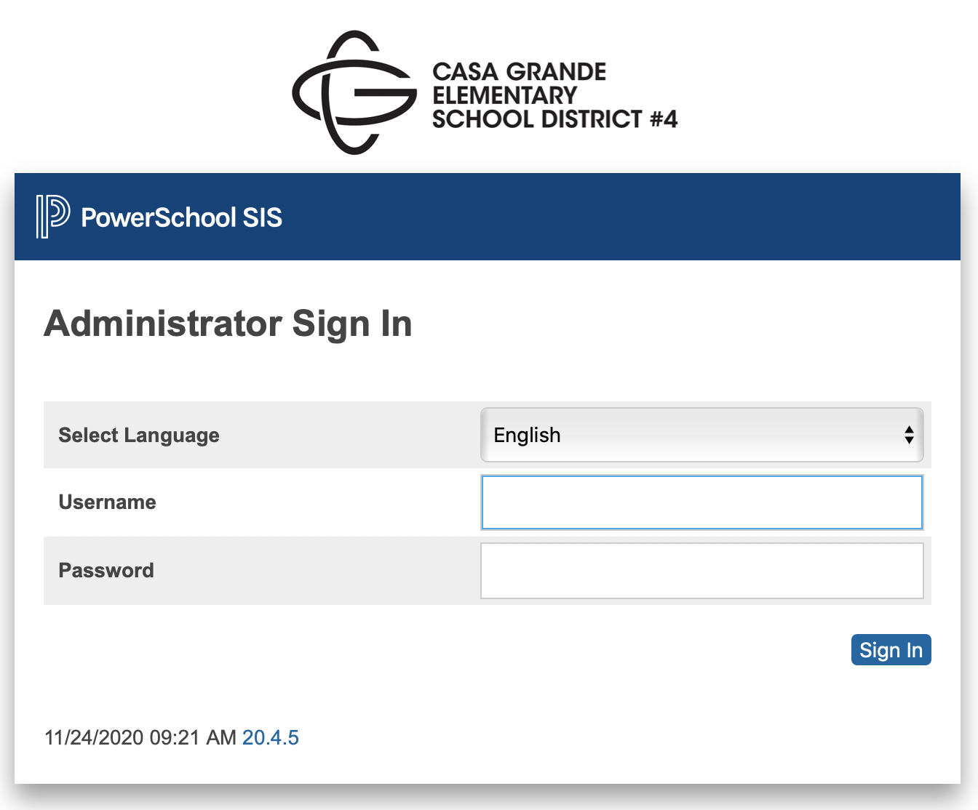

Slide 13
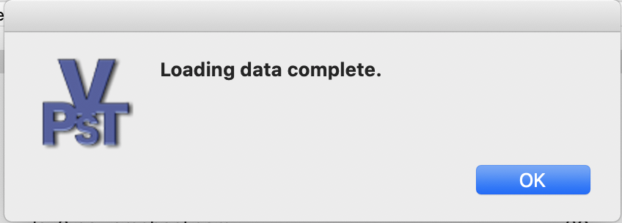
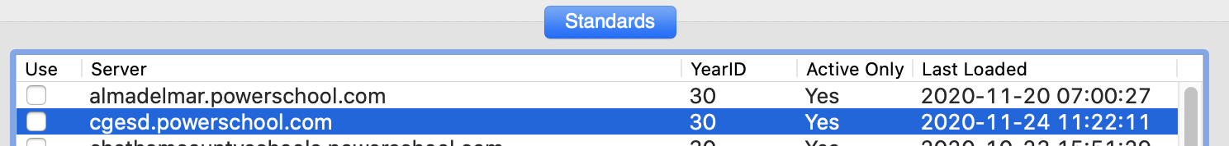
As it’s connecting – VST provides you with various status updates and ends with this…
That’s the date of the last sync!
11/24/20 @ 11:22 AM EST

Slide 14
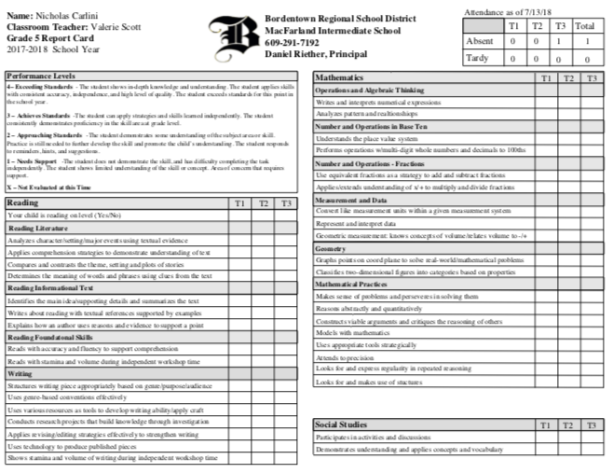
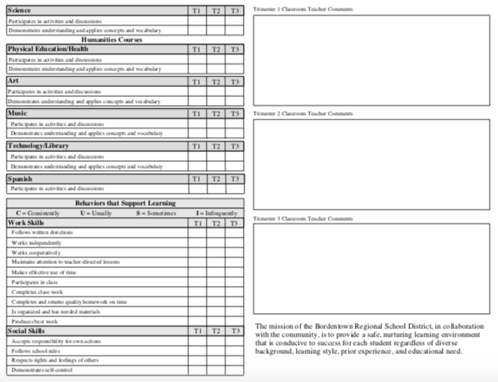
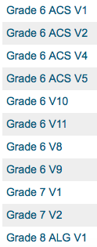
Time Saving Tip
BUILD FOR PERFECTION/SIGN-OFF
CREATE a SINGLE GRADE LEVEL – upload it with different version #’s
FEEDBACK for Curriculum team is essential
DUPLICATE FILE and BEGIN your next Grade Level, section appear on each grade level

Slide 15


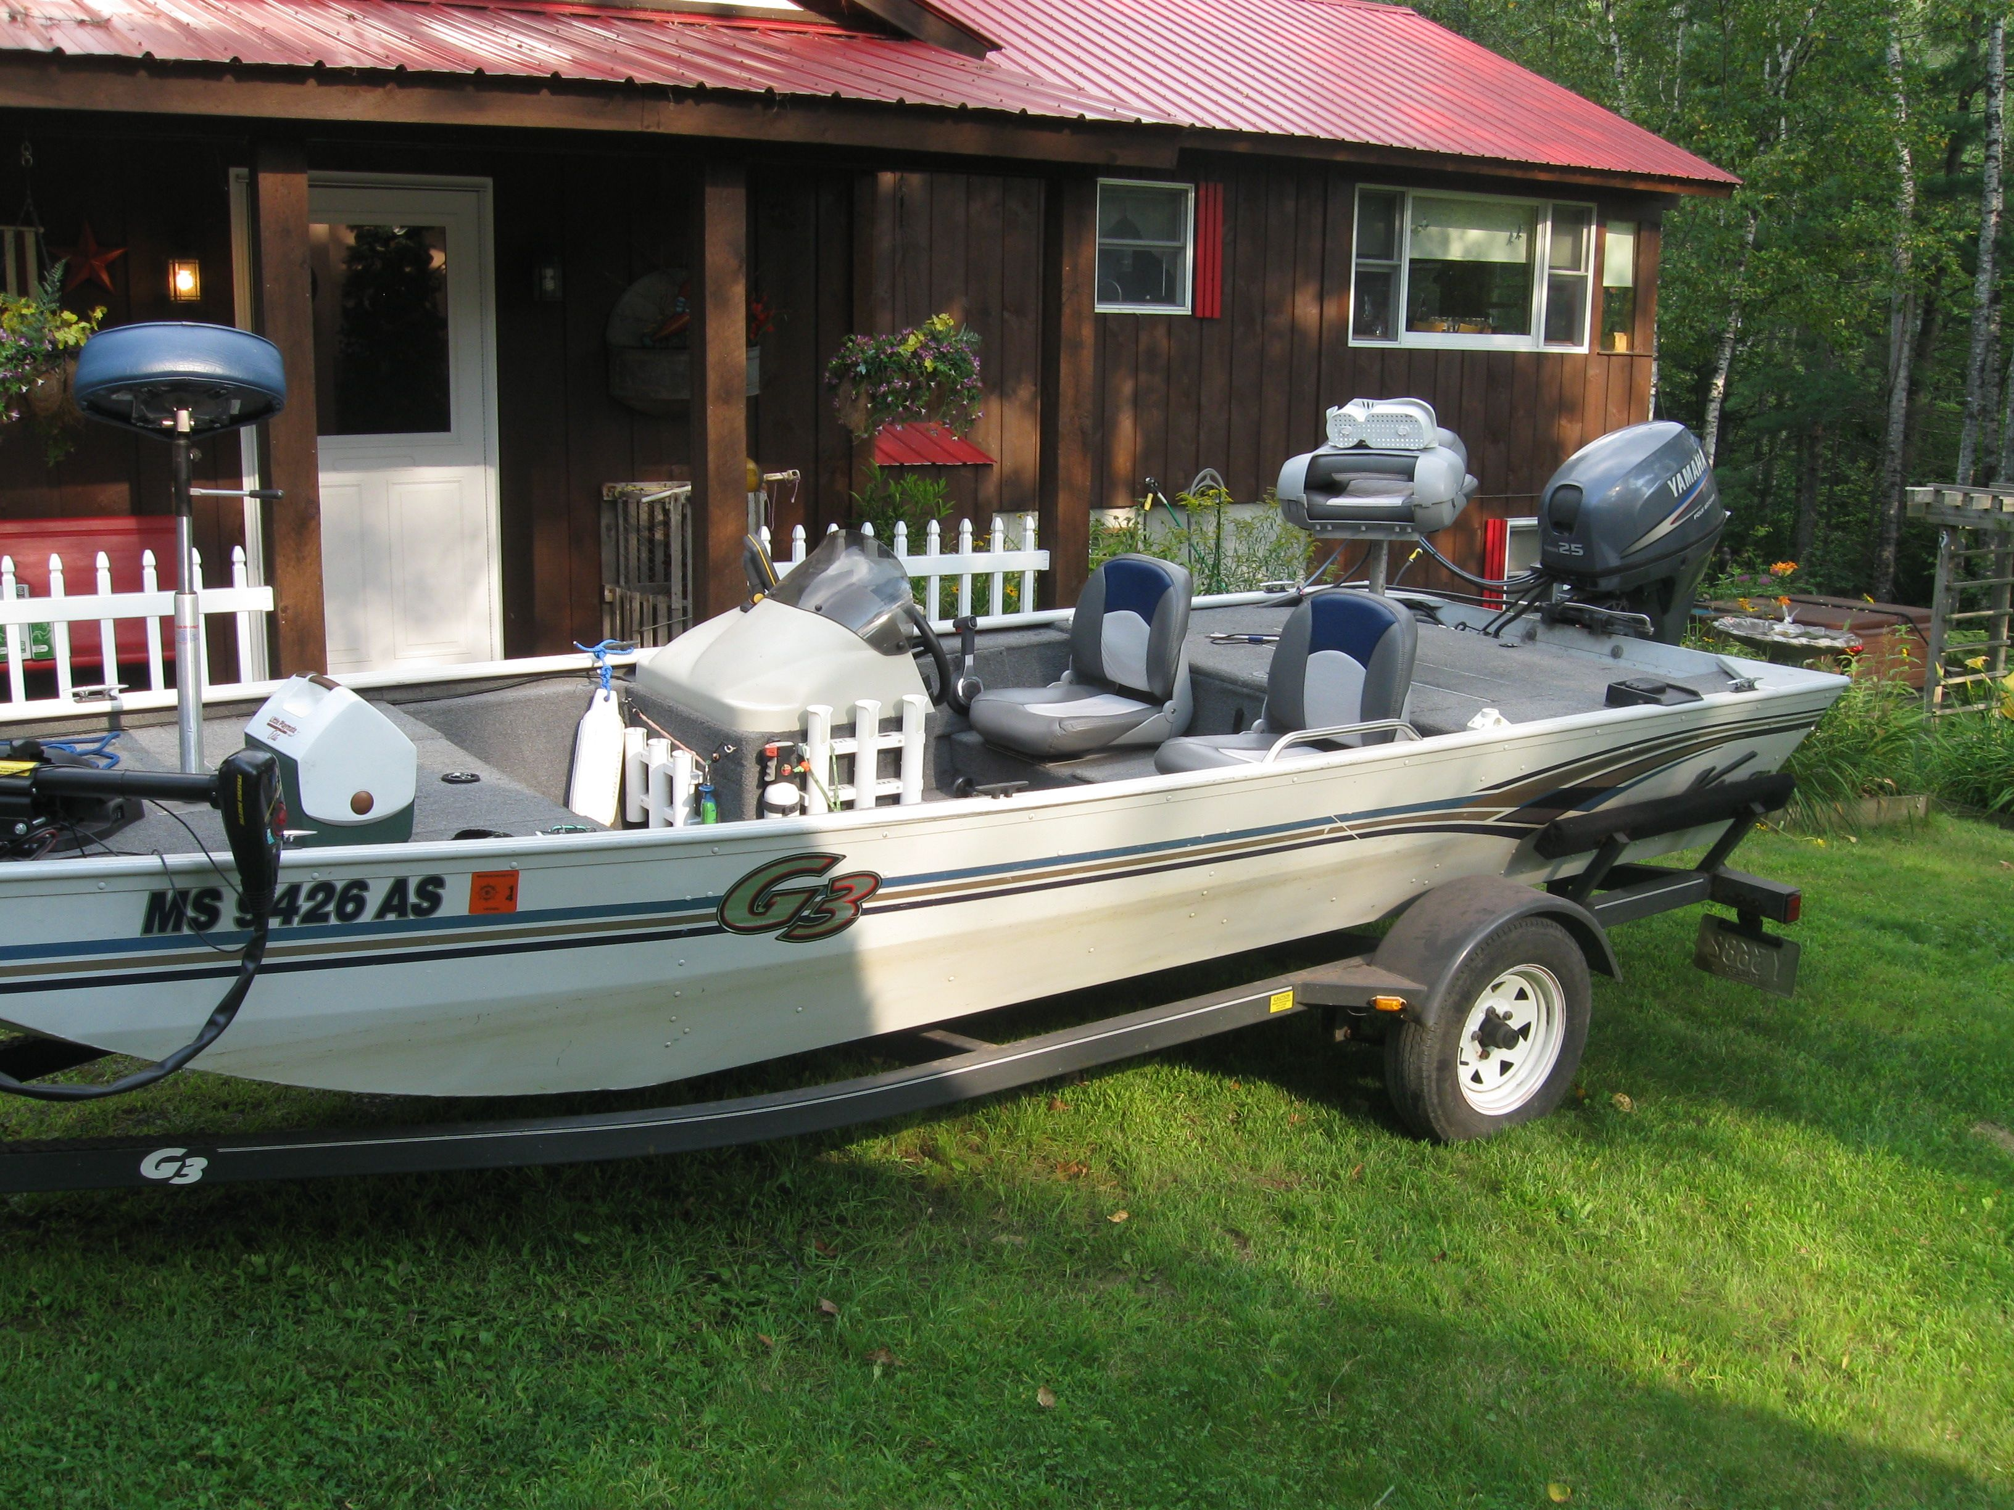
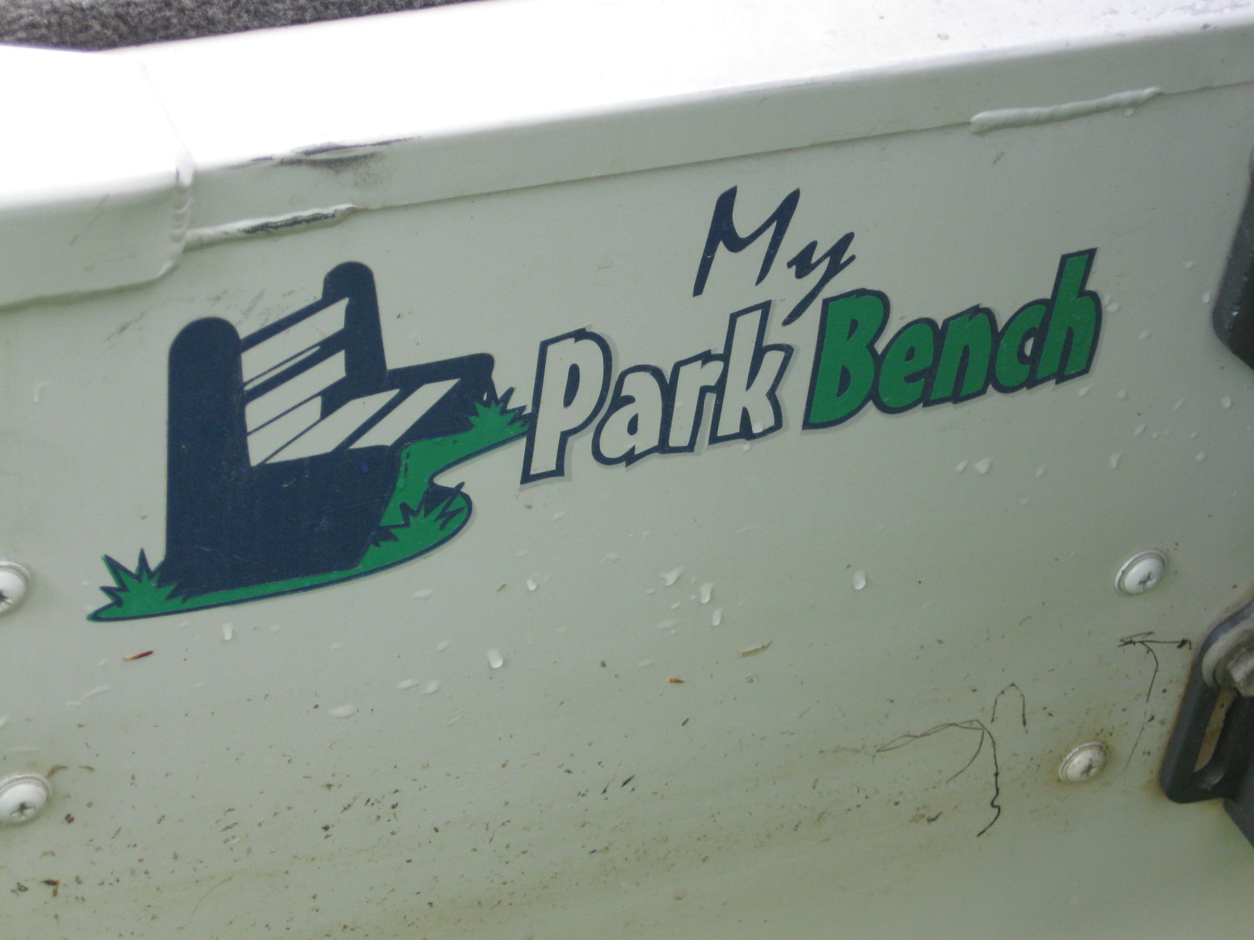
http://www.parkbenchsoftware.com/
Current District Pricing : $395 / year
Demo Licenses are available – send me an email!
get2bobc@gmail.com

Slide 16
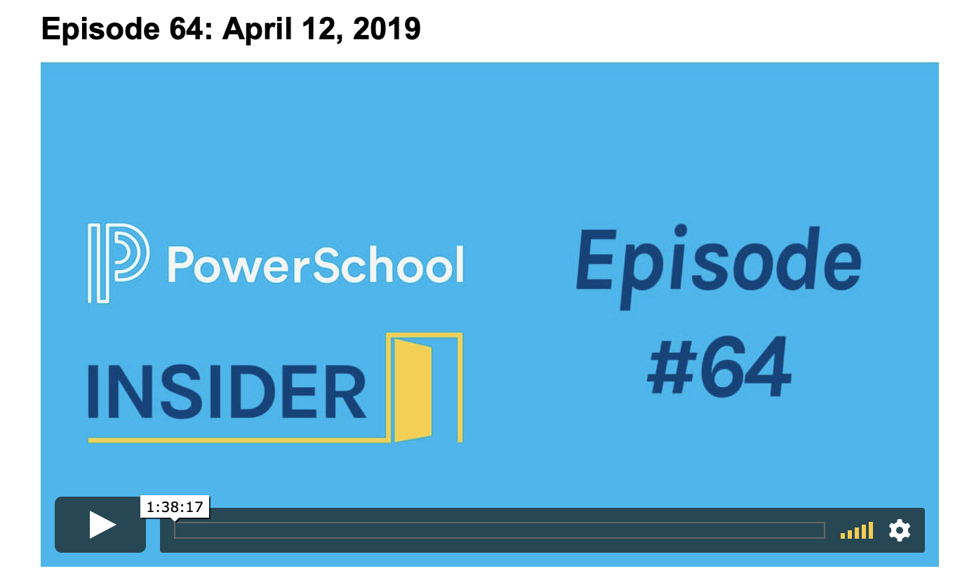
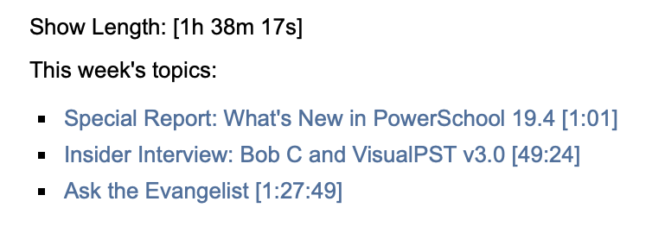


Slide 17
ANY AND ALL DERO RESOURCES ARE AVAILABLE
TO DOWNLOAD, TWEAK and USE FOR YOUR DISTRICT!
Q & A
Bob Cornacchioli
get2bobc@gmail.com
www.derotechnical.com

Slide 18
Let’s Switch to Visual PST Software

